Slide 1
Our Budget Challenge -
Budget Workshop 2016
Hosted by our Connecting Communities Forums

Slide 2
Welcome and aims for the session
Understand our shared budget challenges facing us
Express your views on potential impacts
Explore what you can do -
What are your priorities?
How can our communities help?
Find out what will happen next

Slide 3
Key messages for this evening
1
We have made good progress on delivering savings
2
But there remains a very big budget challenge
3
So we need your help
3

Slide 4
Update on our overall position

Slide 5
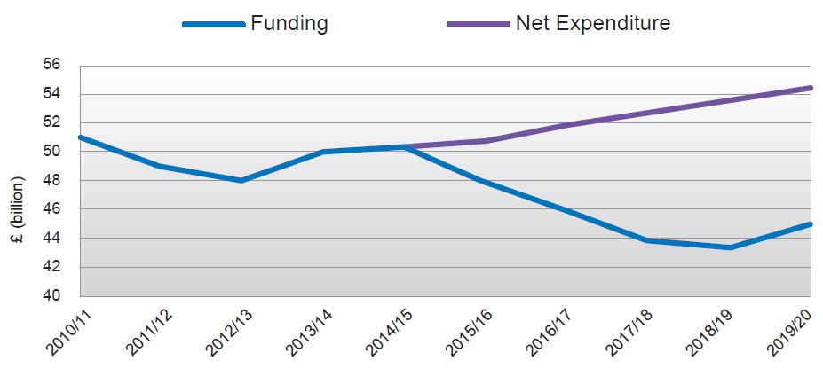
National Local Authority funding and expenditure
Source: LGA – Future Funding Outlook for Councils 2019/20 – 2015 Update

Slide 6
Equivalent to £168 for every man, woman and child alive today in the UK
Equivalent to paying for 13.5 new Wembley Stadiums
Or a 30% rise in Council Tax

Slide 8
The scale of our challenge
Original 4 year challenge- estimated at £43m
Has now increased to £49m due to demographic and cost pressures
After the £12m of savings being made this year, the estimated budget gap is £37m for the next 3 years
Of this £37m, we have found £14m, leaving a further £23m to identify
AND- even more challenges in the future!

Slide 9
Some recent headlines from other local authority areas…
Council cuts bombshell: 'Nothing is safe' as public services brace for £40million hit Plymouth Herald 27 July
Bristol City Council will be cutting 1,000 jobs in bid to save £29 million Bristol Evening Post 22 August
Somerset County Council in £24m overspend warning
BBC news website, 21 September
Wiltshire Council forced to take action to avoid predicted £10 million overspend
Wiltshire Times 11 November

Slide 10
What we are doing to meet the challenge

Slide 11
Bridging the gap- our approach
1
2
3
4
Efficiency
Income
New Models of Delivery
Reduce / Stop

Slide 12
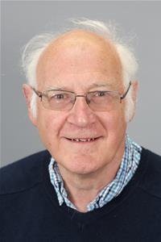
Portfolio- Finance and Efficiency
Cabinet member: Cllr Charles Gerrish
OUR DIRECTION
Half of Council savings in the last 3 years are efficiencies - eg 40% less Council office space
More online services – “Digital by Choice”
Business Rates, City Deal and Devolution
New Council Tax Support Scheme- fairer and easier to administer
OTHER COUNCILS HAVE…
Ended their welfare support schemes
Cut their call centres and made calling the Council more difficult

Slide 13
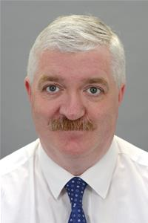
Portfolio: Policy, Localism and Partnerships
Cabinet Member: Cllr Paul Myers
OUR DIRECTION
West of England Devolution Deal - £1bn investment over 30 years
Helping communities to do more for themselves
Work more closely with parish and town councils and voluntary groups
A greater voice for localities
OTHER COUNCILS HAVE…
Not pushed hard for the best deal from devolution
Closed community buildings
Got volunteers to run key services

Slide 14
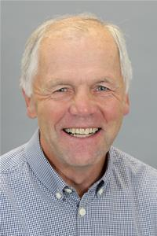
Portfolio: Adult Social Care and Health
Cabinet Member: Cllr Vic Pritchard
OUR DIRECTION
Your Care Your Way- a person-centred approach to health and care for local people including
More joined up and personalised service from young to old
GP hubs at the heart of our communities
Strong focus on preventative services, early intervention and support for the most vulnerable to live more independent lives
OTHER COUNCILS HAVE…
Cut preventative services
Struggled to integrate health and social care
Reduced the time available to support people in their own homes

Slide 15
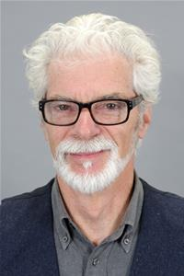
Portfolio: Economic Development
Cabinet Member: Cllr Patrick Anketell-Jones
OUR DIRECTION
Income from Business Rates growth
Enterprise Area Masterplan – North and South Quays
Expanded Enterprise Zone to the Somer Valley
City Deal - already provides for 100% business rates, securing £500M in infrastructure fund investment over 25 years
OTHER COUNCILS HAVE…
Cut capital investment

Slide 16
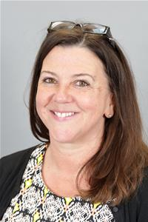
Portfolio: Homes and Planning
Cabinet Member- Cllr Liz Richardson
OUR DIRECTION
West of England ‘Joint Spatial Plan’ to 2036- target of up to 105,000 homes (13,500 in B&NES) and 82,500 jobs. Existing Core Strategies already make provision for some 66,000 dwellings across the WoE.
160 new affordable homes in this financial year in B&NES as part of a three year target of 465 new affordable homes to rent and buy.
Homesearch website upgraded in July 2016 to provide better information for residents.
Investment from Devolution Deal
New Council-owned company to increase housing supply- on track to deliver £500,000 per annum after 4 years
Received £900k from CIL in the last year
OTHER COUNCILS HAVE…
Made slower planning decisions

Slide 17
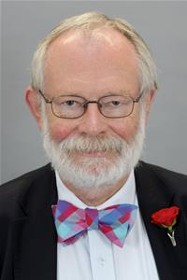
Portfolio: Transport
Cabinet Member- Cllr Anthony Clarke
OUR DIRECTION
£7.5bn package of infrastructure improvements across West of England- currently out for consultation
Devolution- opportunities for investment to cut congestion and better public transport integration (eg bus franchising)
Exploring A36/A46 link
Park and Ride for the City
Pioneering approach to road safety along the A37
LED lighting – cuts energy consumption by up to 60%,
OTHER COUNCILS HAVE…
Cut highways maintenance
Removed bus subsidies

Slide 18
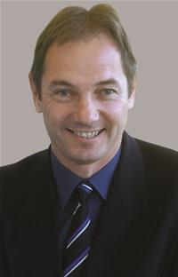
Portfolio: Community Services
Cabinet Member- Cllr Martin Veal
OUR DIRECTION
Greater income generating initiatives (e.g. through events and weddings)
The “Modern Libraries” review
Improving Bath’s leisure centre and a refurbished centre for Keynsham
Revised collection patterns for waste, mitigating against future waste cost increases (80% of household rubbish is reused, recycled or turned into energy)
OTHER COUNCILS HAVE…
Stopped CCTV monitoring
Switched off street lighting in certain times and places
Reduced street cleaning
Closed libraries

Slide 19
Portfolio: Children’s Services
Cabinet Member: Cllr Michael Evans
OUR DIRECTION
Building on the success of Connecting Families
Strengthening early help and focus on prevention
Reviewing transport spend and strategy (community and home to school transport) to better focus on needs
Changing role for local authorities within education
Continuing to improve education outcomes - 95% of pupils are in schools that are ‘good or outstanding’ compared with 88% in the SW and 83% nationally
Challenge of academy schools for our “LEA” role
OTHER COUNCILS HAVE…
Significantly reduced resources provided for early help
Closed almost all their Children’s Centres
Run down their youth services

Slide 20
“The Big Picture” – our key local issues
West of England Devolution= more investment in infrastructure
Your Care Your Way= better integration between health and social care
“Digital by Choice”= more done online, but more help for those who need it
More homes, more jobs, more growth= more business rates income
Business Rate Retention= we can keep 100% of growth in business rates
Communities doing more for themselves= releasing funding to protect the most vulnerable
“Academisation” = reducing support we provide to Academy schools

Slide 21
Key Messages
1
We have made good progress in delivering savings. From 2010/11 to 2016/17 we have saved a total of £77m
2
But there remains a very big budget challenge. This means that the savings needed to close the £23m gap will be much more challenging than previously.
We need your help. We have worked to identify the areas potential further savings may come from, including looking at what other councils have done, but many challenges remain. We need your views on priorities and on how to work with local communities to find new ways of working
3

Slide 22
Working in Groups

Slide 23
But what do you think?
1. What are your concerns about the impacts of the Council’s budget direction in your area?
2. What can you and your community do to help?
3. What do you think about what other councils have done?

Slide 24
Feedback from groups

Slide 25
Thanks for attending!

Slide 27
Next steps and timetable
When | What | Purpose
21st November | Somer Valley Forum | Public Engagement/Consultation
22nd November | Keynsham Area Forum | Public Engagement/Consultation
23rd November | Resources Policy Development and Scrutiny Panel | Briefing for PDS Panel members.
23rd November | Autumn Statement | Central Government announcement
28th November | Bathavon Forum | Public Engagement/Consultation
29th November | Chew Valley Forum | Public Engagement/Consultation
1st December | Bath City Forum | Public Engagement/Consultation
Early December | Government Local Government “Settlement” expected | Central Government announcement
From 3rd January | Directorate Plans published | For Policy Development and Scrutiny Panels
10th January | Planning, Housing and Economic Development Policy Development and Scrutiny Panel | Scrutiny Panel
16th January | Communities, Transport and Environment Policy Development and Scrutiny Panel | Scrutiny Panel
17th January | Children and Young People Policy Development and Scrutiny Panel | Scrutiny Panel
25th January | Health and Wellbeing Select Committee | Scrutiny Panel
30th January | Resources Policy Development and Scrutiny Panel | Scrutiny Panel
25 January | Cabinet budget papers published | Papers available
1st February | Cabinet Meeting | Set Budget
14th February | Council Budget Meeting | Agree Budget
23rd February | Reserve Cabinet Meeting

Slide 28
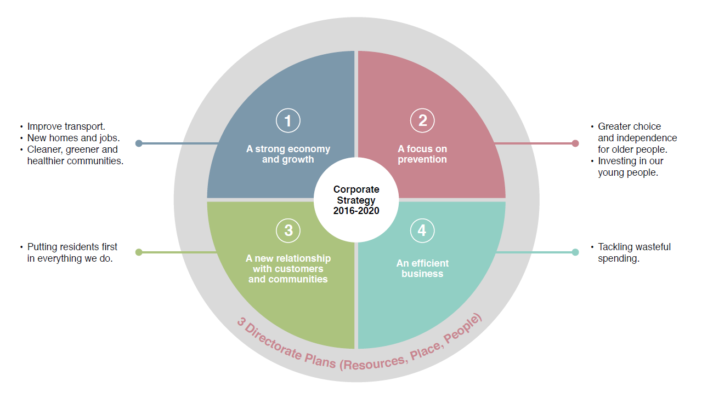
Our Priorities

Slide 29
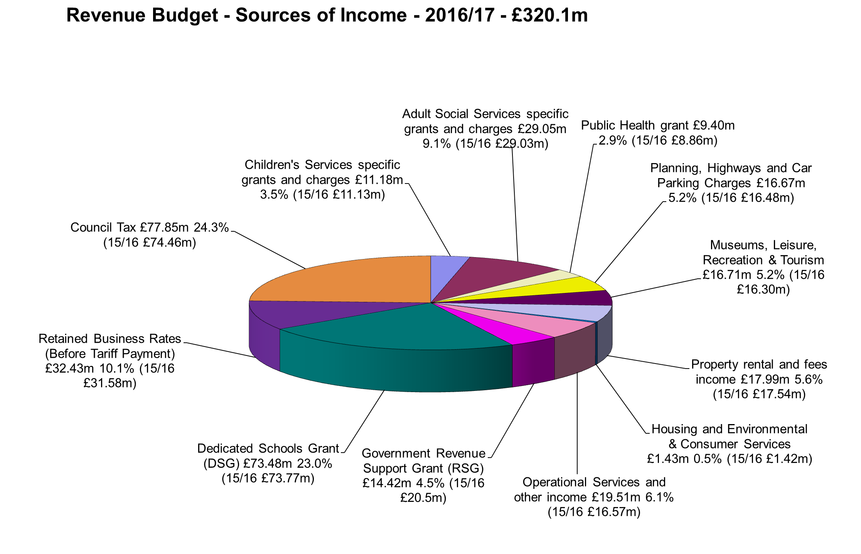
Our budget: income

Slide 30
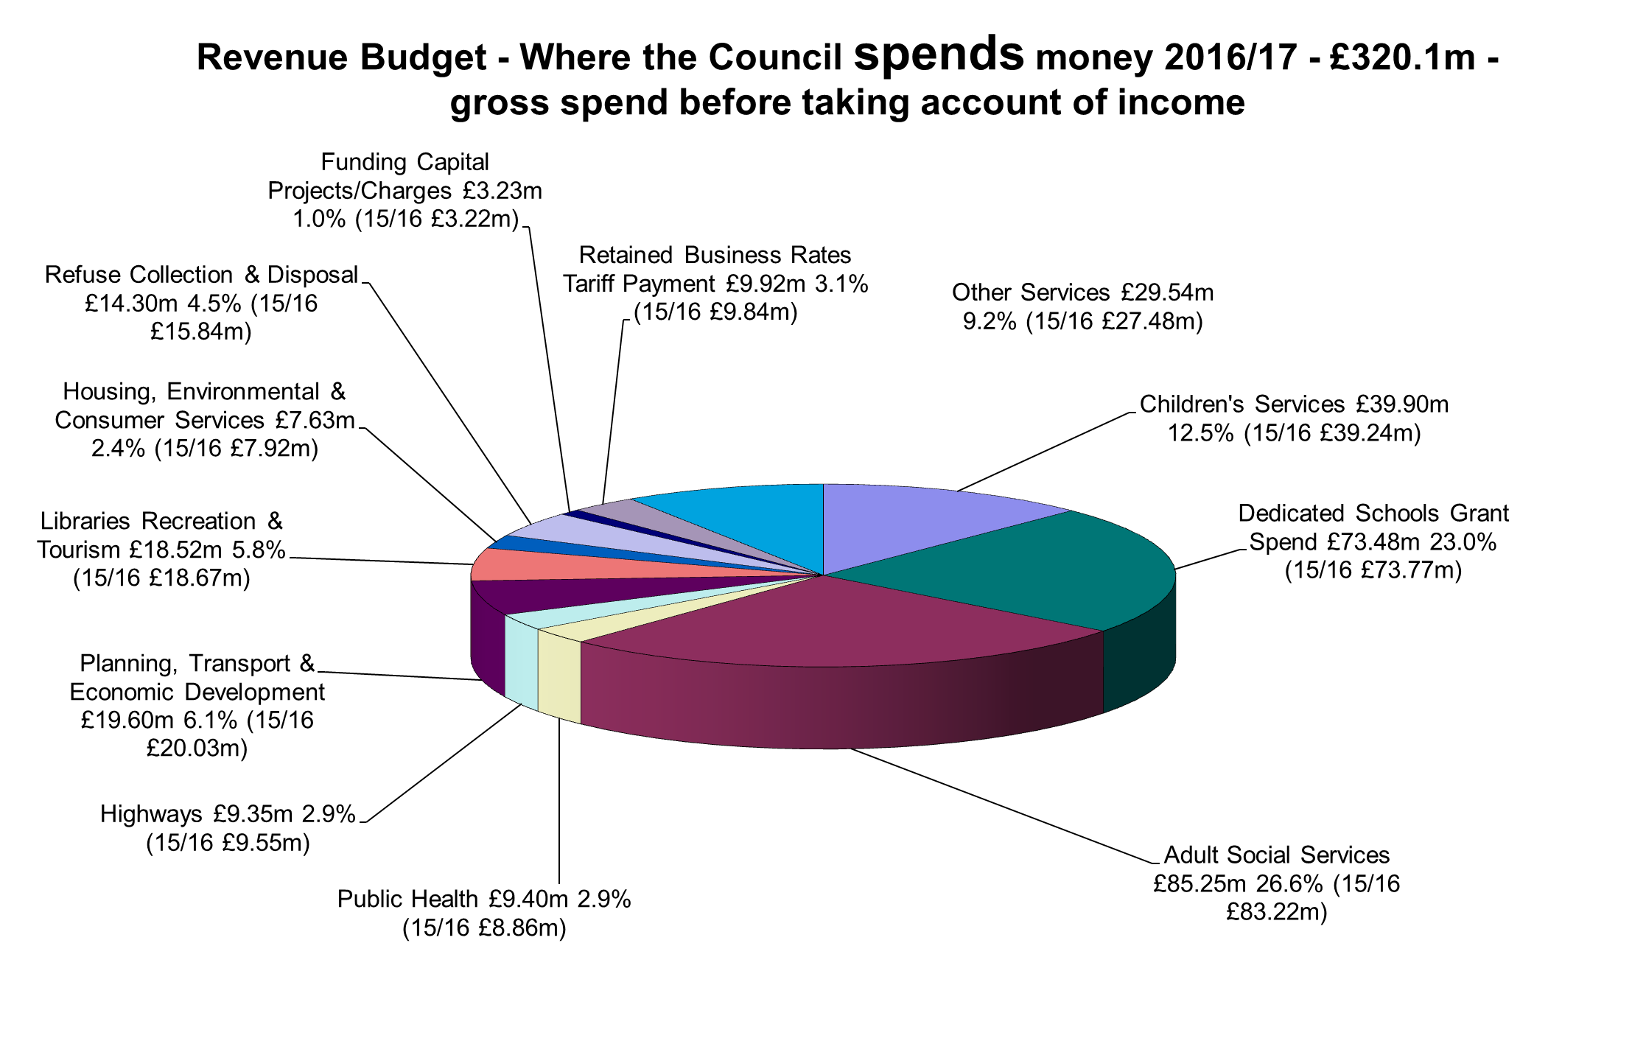
Our budget: spending

Slide 32
Savings already in place- including £12m in progress 2016/17

