Slide 1
West of England Consultation Joint Spatial Plan and Joint Transport Study
Bath City Forum 1st December 2016

Slide 2
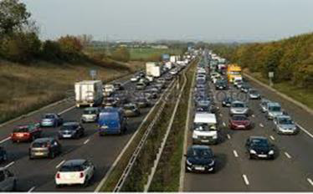
Critical Issues
The national housing crisis
Maintain economic prosperity - brings substantial benefit for residents, communities & the environment.
Pressure on infrastructure, especially transport: - inhibits wealth creation and productivity & unsustainable patterns of travel are a contribute to climate change & poor health
Our world class environment brings substantial economic & community benefits including quality of life of residents, visitors and businesses.

Slide 3
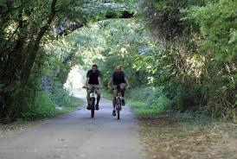
Working Together
Joint approach to strategic planning & transport issues:
The JSP will:
be a statutory Development Plan Document for 2016-2036
A plan for the West of England
identify the number of new homes & employment land across the West of England
set out the spatial strategy for growth
The JTS will :
look at current & future challenges on our network
identify transport infrastructure needed to support development.

Slide 4
JSP Strategic Priorities
Economic: To identify and meet the need for housing and accommodate the economic growth objectives of the LEP Strategic Economic Plan
Social: ensure all sections of our communities benefit
Environment: protect & enhance the sub-region’s diverse & high quality environment and ensuring resilience.
Infrastructure: new development is properly aligned with transport and other social infrastructure.

Slide 5
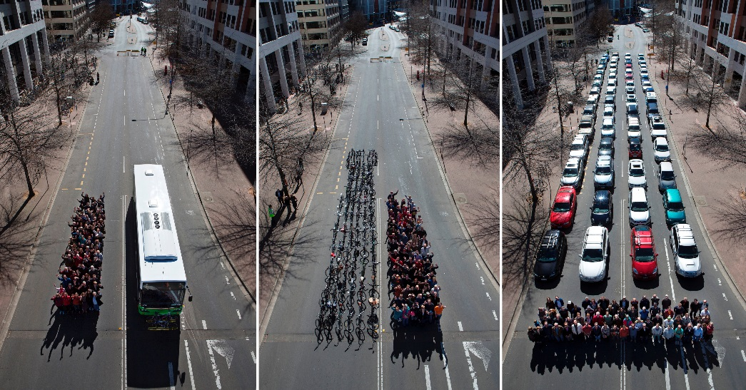
Transport Vision – Key Principles
Transport Vision aims and ambitions.
2015/16 consultation called for investment on public transport corridors, walking and cycling.
Need for affordable, reliable sustainable travel options, emphasis on smarter travel choices & new technology.
Corridor Packages – investment in bypasses and orbital links enables delivery of high quality public transport and cycling corridors.
Physical restrictions on traffic
and/or financial restraint
– no easy options.

Slide 6
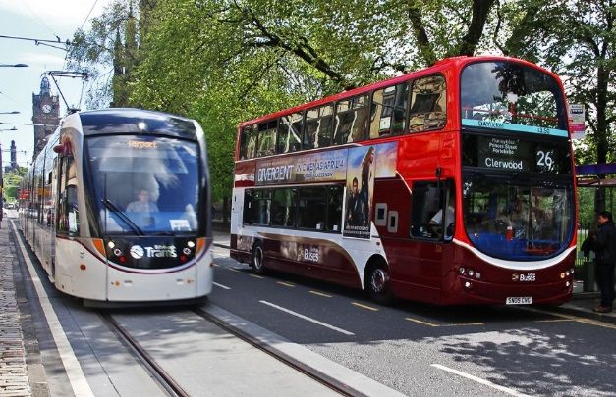
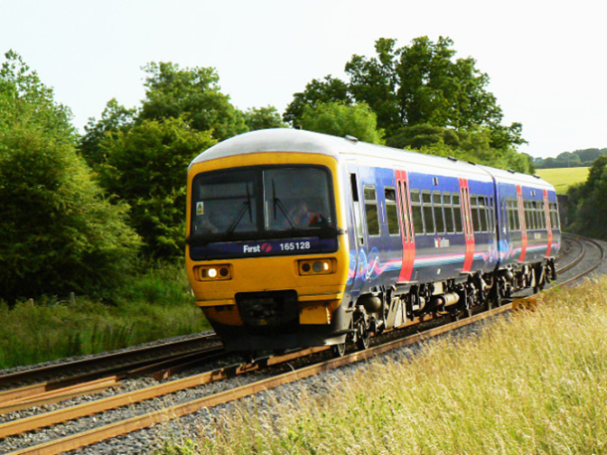
Transport Vision – Corridor Key Features
Ambition for core Light Rapid Transit network, plus MetroBus extensions and strategic cycling corridors.
Key enabling highway schemes and upgrades.
Core roles of Bristol Airport and Port.
Local rail improvements – increased frequencies and new stations.
New motorway junctions, dynamic motorway management and A36/A46 link.
Bristol and Weston-super-Mare area packages.
Strong overlap with Joint Spatial Plan’s emerging locations, and transport packages to address impact of development sites.

Slide 7
Housing Target 2016-2036
120,000
100,000
80,000
60,000
40,000
20,000
Up to 105,000 dgs
Flexibility 2.7%
JSP to identify 39,000 dgs
13,500 B&NES
Wider Bristol
88,700
Of 14,600
brownfield dgs
Committed
66,000
Target
Supply

Slide 8
Affordable Housing 2016 - 2036
120,000
100,000
80,000
60,000
40,000
20,000
105,000 dgs
Affordable Housing need 32,200
17,100
Target
Supply

Slide 9
Which spatial scenario would likely be best to deliver the plan’s objectives?

Slide 10
B&NES Core Strategy 2011-2029
District Heating
Green Belt
AONB
Urb Extension
GB Release

Slide 11
Emerging Spatial Strategy

Slide 12
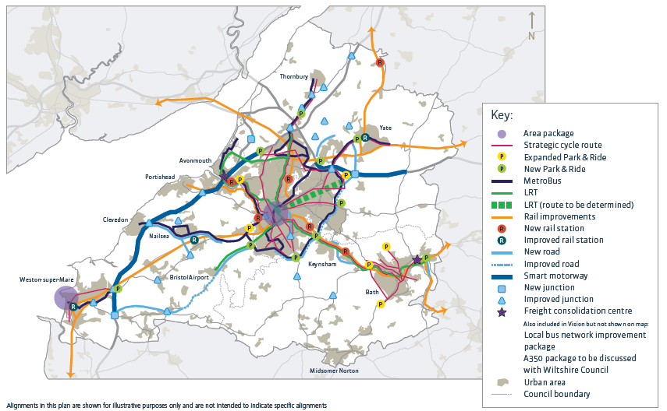
Transport Vision – Overall Package

Slide 13
How have the transport proposals for the Bath area been formed?
Primary focus on current challenges and growth from committed development.
Transport proposals address movements on key corridors, including those affected by ESS growth elsewhere.
Transport proposals reflect JTS key principles and B&NES Council policy, designed to focus on sustainable travel.

Slide 14
What are the Transport Proposals for Bath & Bathavon?
Walking & cycling package:
EA connections.
Strategic cycle routes.
Conventional bus upgrading.
Expanded and new Park & Ride facilities:
Newbridge.
Lansdown.
Odd Down.
East of Bath.

Slide 15
What are the Transport Proposals for Bath & Bathavon? (continued)
A4 corridor Bath-Saltford-Keynsham-Bristol:
First Metrobus?
Ultimately Light Rail Transit.
East of Bath link:
Partnership working with neighbouring councils.
Highways England delivery
Freight consolidation centre.

Slide 16
Deliverability
The Transport Vision costs £7.5bn.
About a ¼ of this mitigates the Emerging Spatial Strategy.
Working with partners – Highways England, Network Rail, Port & Airport.
Lobbying for funding, and identifying opportunities for innovative funding.
Next stage - phasing and prioritisation of schemes – a delivery plan.
Recognise that failure to provide adequate infrastructure will pose a significant delivery risk to development at this location.

Slide 17
A New Local Plan for B&NES
Combine Core Strategy & Placemaking Plan
Roll forward policies to 2036
Allocate JSP Strategic locations (new Green Belt boundary)
Set out site development & design principles
Designate and infrastructure proposals
Other housing/ employment land supply – allocate other sites
Approach to affordable housing policy
Universities and student accommodation
new policies warranted by new legislation, a time related target e.g. retail capacity, renewable energy targets

Slide 18
Consultation arrangements
Consultation period - 7th November to 19th December
Article Winter edition of Connect magazine
Mailout to all who have expressed an interest
Nov Forum meetings
Stakeholders

Slide 19
Consultation arrangements
Roving exhibitions:
Keynsham library: 7th – 18th November
Midsomer Norton: The Hollies 21st November –2nd Dec
Bath One Stop Shop: 5th - 16th December
Workshops
Whitchurch – 6 pm 15th Nov
Keynsham – 6 pm 30th Nov
Nov Forum meetings

Slide 20
Next Steps
JSP
JTS
B&NES Local Plan
Nov-Dec 2016
Emerging Strategy
consultation
Transport Vision
Commencement
consultation
Consider reps
JTS
recommendations
Spring 2017
Draft Plan consultation
Update JLTP
Options
consultation
Mid-2017

Slide 21
Thank you for listening.

Slide 22
Green Belt

