Slide 1
Pharmaceutical Services in B&NES: the 2015 Pharmaceutical Needs Assessment (PNA)
Paul Scott, Assistant Director of Public Health,
Joe Prince, Senior Public Health Research & Intelligence Officer, Public Health, B&NES

Slide 2
Why are we here?
Notes:
These figures are 2006/07 annual estimated costs of alcohol to the NHS from DOH (£2.7 billion) – Government alcohol strategy 2012 – estimated costs to society as whole £21 billion
56% spent on frontline inpatient and outpatient hospital treatment
Problem drinkers consult GP twice as often as the average patient
Prescriptions dispensed to treat alcohol dependency in England have increased by almost 75 per cent in nine years – now costs nearly £3 million annually compared to £1.7 mill in 2003
Estimated cost to society locally is:
In B&NES £3.2 m in Drug & alcohol treatment services
We estimate that up to £5.0 million is spent yearly on health care for alcohol-use disorders in B&NES
We estimate up to £18.7 million is lost yearly due to the economic output reduction caused by alcohol-use disorders in B&NES
The total cost in B&NES of the harm arising from alcohol-use disorders is some £45.0 million a year - includes £21 million costs of crime.

Slide 3
B&NES Health and Wellbeing Board
B&NES Joint Strategic Needs Assessment (JSNA)
Purpose of this PNA
Notes:
These figures are 2006/07 annual estimated costs of alcohol to the NHS from DOH (£2.7 billion) – Government alcohol strategy 2012 – estimated costs to society as whole £21 billion
56% spent on frontline inpatient and outpatient hospital treatment
Problem drinkers consult GP twice as often as the average patient
Prescriptions dispensed to treat alcohol dependency in England have increased by almost 75 per cent in nine years – now costs nearly £3 million annually compared to £1.7 mill in 2003
Estimated cost to society locally is:
In B&NES £3.2 m in Drug & alcohol treatment services
We estimate that up to £5.0 million is spent yearly on health care for alcohol-use disorders in B&NES
We estimate up to £18.7 million is lost yearly due to the economic output reduction caused by alcohol-use disorders in B&NES
The total cost in B&NES of the harm arising from alcohol-use disorders is some £45.0 million a year - includes £21 million costs of crime.

Slide 4
B&NES Health and Wellbeing Board
responsible for improving the health and wellbeing of people in B&NES.
principle point of integration between the reformed health system and social care.
Notes:
These figures are 2006/07 annual estimated costs of alcohol to the NHS from DOH (£2.7 billion) – Government alcohol strategy 2012 – estimated costs to society as whole £21 billion
56% spent on frontline inpatient and outpatient hospital treatment
Problem drinkers consult GP twice as often as the average patient
Prescriptions dispensed to treat alcohol dependency in England have increased by almost 75 per cent in nine years – now costs nearly £3 million annually compared to £1.7 mill in 2003
Estimated cost to society locally is:
In B&NES £3.2 m in Drug & alcohol treatment services
We estimate that up to £5.0 million is spent yearly on health care for alcohol-use disorders in B&NES
We estimate up to £18.7 million is lost yearly due to the economic output reduction caused by alcohol-use disorders in B&NES
The total cost in B&NES of the harm arising from alcohol-use disorders is some £45.0 million a year - includes £21 million costs of crime.

Slide 5
B&NES’s Joint Strategic Needs Assessment (JSNA) looks at the current and future health and care needs of its local population to inform and guide the planning and commissioning (buying) of health, well-being and social care services within a local authority area.
http://www.bathnes.gov.uk/jsna
Notes:
These figures are 2006/07 annual estimated costs of alcohol to the NHS from DOH (£2.7 billion) – Government alcohol strategy 2012 – estimated costs to society as whole £21 billion
56% spent on frontline inpatient and outpatient hospital treatment
Problem drinkers consult GP twice as often as the average patient
Prescriptions dispensed to treat alcohol dependency in England have increased by almost 75 per cent in nine years – now costs nearly £3 million annually compared to £1.7 mill in 2003
Estimated cost to society locally is:
In B&NES £3.2 m in Drug & alcohol treatment services
We estimate that up to £5.0 million is spent yearly on health care for alcohol-use disorders in B&NES
We estimate up to £18.7 million is lost yearly due to the economic output reduction caused by alcohol-use disorders in B&NES
The total cost in B&NES of the harm arising from alcohol-use disorders is some £45.0 million a year - includes £21 million costs of crime.

Slide 6
Purpose of PNA
to guide “market-entry‟ for new contractors and;
to guide commissioning of services from pharmacies.
to make sure we are delivering the services that local people need
Notes:
These figures are 2006/07 annual estimated costs of alcohol to the NHS from DOH (£2.7 billion) – Government alcohol strategy 2012 – estimated costs to society as whole £21 billion
56% spent on frontline inpatient and outpatient hospital treatment
Problem drinkers consult GP twice as often as the average patient
Prescriptions dispensed to treat alcohol dependency in England have increased by almost 75 per cent in nine years – now costs nearly £3 million annually compared to £1.7 mill in 2003
Estimated cost to society locally is:
In B&NES £3.2 m in Drug & alcohol treatment services
We estimate that up to £5.0 million is spent yearly on health care for alcohol-use disorders in B&NES
We estimate up to £18.7 million is lost yearly due to the economic output reduction caused by alcohol-use disorders in B&NES
The total cost in B&NES of the harm arising from alcohol-use disorders is some £45.0 million a year - includes £21 million costs of crime.

Slide 7
Who Uses a PNA?
Potential contractors – to apply to open new premises
Existing contractors – to identify new services which they could provide
NHS England Area Teams – to make decisions on applications for new contractor premises or services, make decisions on applications to relocate existing premises and commissioning of enhanced services
Health and Wellbeing Boards – to guide commissioning of pharmacy-led Public Health services to address health inequalities and improve the health of their population.
Notes:
These figures are 2006/07 annual estimated costs of alcohol to the NHS from DOH (£2.7 billion) – Government alcohol strategy 2012 – estimated costs to society as whole £21 billion
56% spent on frontline inpatient and outpatient hospital treatment
Problem drinkers consult GP twice as often as the average patient
Prescriptions dispensed to treat alcohol dependency in England have increased by almost 75 per cent in nine years – now costs nearly £3 million annually compared to £1.7 mill in 2003
Estimated cost to society locally is:
In B&NES £3.2 m in Drug & alcohol treatment services
We estimate that up to £5.0 million is spent yearly on health care for alcohol-use disorders in B&NES
We estimate up to £18.7 million is lost yearly due to the economic output reduction caused by alcohol-use disorders in B&NES
The total cost in B&NES of the harm arising from alcohol-use disorders is some £45.0 million a year - includes £21 million costs of crime.

Slide 8
Key issues for IEAG to consider
Pharmaceutical Services
Location of Pharmacies
Pharmacy Provision in B&NES
Accessibility of Consultation Rooms
Opening Hours
Languages spoken
Consultation Questions
Notes:
These figures are 2006/07 annual estimated costs of alcohol to the NHS from DOH (£2.7 billion) – Government alcohol strategy 2012 – estimated costs to society as whole £21 billion
56% spent on frontline inpatient and outpatient hospital treatment
Problem drinkers consult GP twice as often as the average patient
Prescriptions dispensed to treat alcohol dependency in England have increased by almost 75 per cent in nine years – now costs nearly £3 million annually compared to £1.7 mill in 2003
Estimated cost to society locally is:
In B&NES £3.2 m in Drug & alcohol treatment services
We estimate that up to £5.0 million is spent yearly on health care for alcohol-use disorders in B&NES
We estimate up to £18.7 million is lost yearly due to the economic output reduction caused by alcohol-use disorders in B&NES
The total cost in B&NES of the harm arising from alcohol-use disorders is some £45.0 million a year - includes £21 million costs of crime.

Slide 9
Pharmaceutical Services provided in B&NES
Dispensing of medicines
Repeat dispensing
Safe disposal of unwanted medicines
Signposting
Support for self-care
Medicines Use Reviews (MURs)
New Medicines Service (NMS)
Appliance Use Reviews (AURs)
Stoma Appliance Customisation (SAC)
Specialist Drugs (Palliative Care) Enhanced Service
Sexual Health Services (chlamydia testing and treatment, EHC and C-Card)
Smoking Cessation Services (stop smoking and NRT)
Substance Misuse Services (Needle and Syringe programmes and supervised consumption)
Notes:
These figures are 2006/07 annual estimated costs of alcohol to the NHS from DOH (£2.7 billion) – Government alcohol strategy 2012 – estimated costs to society as whole £21 billion
56% spent on frontline inpatient and outpatient hospital treatment
Problem drinkers consult GP twice as often as the average patient
Prescriptions dispensed to treat alcohol dependency in England have increased by almost 75 per cent in nine years – now costs nearly £3 million annually compared to £1.7 mill in 2003
Estimated cost to society locally is:
In B&NES £3.2 m in Drug & alcohol treatment services
We estimate that up to £5.0 million is spent yearly on health care for alcohol-use disorders in B&NES
We estimate up to £18.7 million is lost yearly due to the economic output reduction caused by alcohol-use disorders in B&NES
The total cost in B&NES of the harm arising from alcohol-use disorders is some £45.0 million a year - includes £21 million costs of crime.

Slide 10
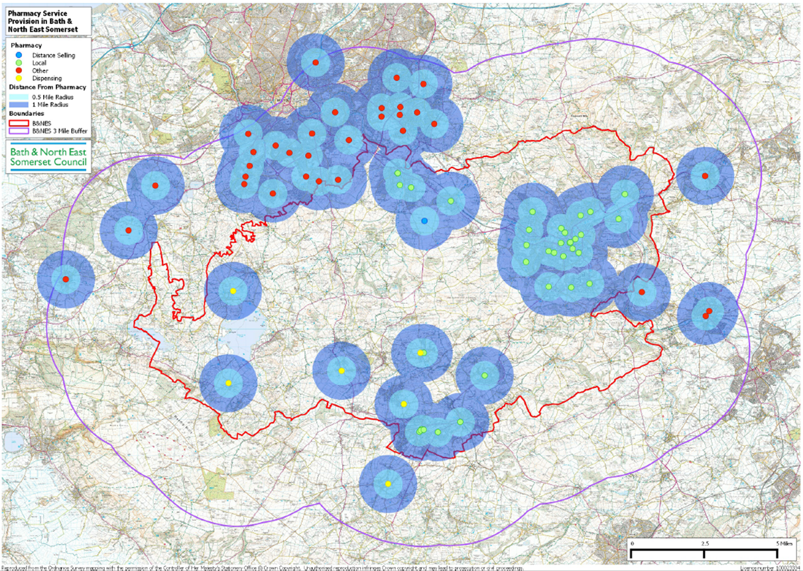
Notes:
These figures are 2006/07 annual estimated costs of alcohol to the NHS from DOH (£2.7 billion) – Government alcohol strategy 2012 – estimated costs to society as whole £21 billion
56% spent on frontline inpatient and outpatient hospital treatment
Problem drinkers consult GP twice as often as the average patient
Prescriptions dispensed to treat alcohol dependency in England have increased by almost 75 per cent in nine years – now costs nearly £3 million annually compared to £1.7 mill in 2003
Estimated cost to society locally is:
In B&NES £3.2 m in Drug & alcohol treatment services
We estimate that up to £5.0 million is spent yearly on health care for alcohol-use disorders in B&NES
We estimate up to £18.7 million is lost yearly due to the economic output reduction caused by alcohol-use disorders in B&NES
The total cost in B&NES of the harm arising from alcohol-use disorders is some £45.0 million a year - includes £21 million costs of crime.

Slide 11
Pharmacy Contractors, B&NES and Neighbouring Authorities (31st March 2013)
Primary Care Trust (PCT) | Number of Pharmacy Contractors | Population (000’s) Mid-2011⁽¹⁾ | Pharmacy Contractors (per 100,000 population)
England | 11,495 | 53,107 | 22
South West | 1,048 | 5,301 | 20
Bath and North East Somerset | 39 | 176 | 22
Bristol Teaching | 96 | 428 | 22
North Somerset | 42 | 203 | 21
Somerset | 102 | 532 | 19
South Gloucestershire | 54 | 263 | 20
Wiltshire | 74 | 474 | 16
Notes:
These figures are 2006/07 annual estimated costs of alcohol to the NHS from DOH (£2.7 billion) – Government alcohol strategy 2012 – estimated costs to society as whole £21 billion
56% spent on frontline inpatient and outpatient hospital treatment
Problem drinkers consult GP twice as often as the average patient
Prescriptions dispensed to treat alcohol dependency in England have increased by almost 75 per cent in nine years – now costs nearly £3 million annually compared to £1.7 mill in 2003
Estimated cost to society locally is:
In B&NES £3.2 m in Drug & alcohol treatment services
We estimate that up to £5.0 million is spent yearly on health care for alcohol-use disorders in B&NES
We estimate up to £18.7 million is lost yearly due to the economic output reduction caused by alcohol-use disorders in B&NES
The total cost in B&NES of the harm arising from alcohol-use disorders is some £45.0 million a year - includes £21 million costs of crime.

Slide 12
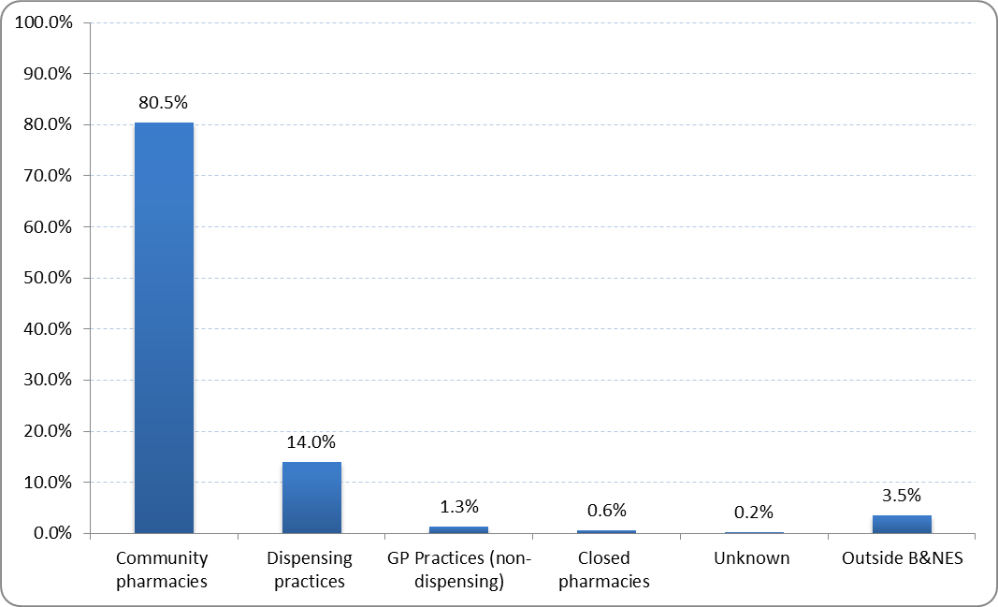
Percentage of B&NES CCG Prescribed Items Dispensed by Pharmacy Type, 2013/14
Notes:
These figures are 2006/07 annual estimated costs of alcohol to the NHS from DOH (£2.7 billion) – Government alcohol strategy 2012 – estimated costs to society as whole £21 billion
56% spent on frontline inpatient and outpatient hospital treatment
Problem drinkers consult GP twice as often as the average patient
Prescriptions dispensed to treat alcohol dependency in England have increased by almost 75 per cent in nine years – now costs nearly £3 million annually compared to £1.7 mill in 2003
Estimated cost to society locally is:
In B&NES £3.2 m in Drug & alcohol treatment services
We estimate that up to £5.0 million is spent yearly on health care for alcohol-use disorders in B&NES
We estimate up to £18.7 million is lost yearly due to the economic output reduction caused by alcohol-use disorders in B&NES
The total cost in B&NES of the harm arising from alcohol-use disorders is some £45.0 million a year - includes £21 million costs of crime.

Slide 13
B&NES Pharmacy Contractors – Accessibility of Consultation Rooms
…35 out of 38 pharmacies that stated that they have a consultation room
Accessibility of Consultation Room(s) | B&NES |  | Bath Central |  | Bath West |  | Bath East |  | Norton Radstock |  | Chew/ Keynsham
 | No. | % | No | % | No. | % | No. | % | No. | % | No | %
With wheelchair access | 26 | 74 | 11 | 79 | 14 | 74 | 10 | 71 | 7 | 88 | 5 | 100
Without wheelchair access | 9 | 26 | 3 | 21 | 5 | 26 | 4 | 29 | 1 | 13 | 0 | 0
Notes:
These figures are 2006/07 annual estimated costs of alcohol to the NHS from DOH (£2.7 billion) – Government alcohol strategy 2012 – estimated costs to society as whole £21 billion
56% spent on frontline inpatient and outpatient hospital treatment
Problem drinkers consult GP twice as often as the average patient
Prescriptions dispensed to treat alcohol dependency in England have increased by almost 75 per cent in nine years – now costs nearly £3 million annually compared to £1.7 mill in 2003
Estimated cost to society locally is:
In B&NES £3.2 m in Drug & alcohol treatment services
We estimate that up to £5.0 million is spent yearly on health care for alcohol-use disorders in B&NES
We estimate up to £18.7 million is lost yearly due to the economic output reduction caused by alcohol-use disorders in B&NES
The total cost in B&NES of the harm arising from alcohol-use disorders is some £45.0 million a year - includes £21 million costs of crime.

Slide 14
B&NES Pharmacy Contractors – Opening Hours
 | B&NES | Bath Central | Bath West | Bath East | Norton Radstock | Chew/ Keynsham
Pharmacy Contractors
100-hour Pharmacy | 1 | 0 | 0 | 0 | 1 | 0
7-days a week | 4 | 4 | 4 | 4 | 0 | 0
all-day Saturday | 8 | 3 | 3 | 3 | 3 | 2
half-day Saturday | 18 | 6 | 7 | 7 | 4 | 3
Monday to Friday only | 7 | 3 | 7 | 1 | 0 | 0
GP Dispensing Practices
half-day Saturday | 2 |  |  |  | 1 | 1
Monday to Friday only | 3 |  |  |  | 3 | 0
…all the 7-day a week pharmacies (including the 100-hour pharmacy) have wheelchair accessible consulting rooms.
Notes:
These figures are 2006/07 annual estimated costs of alcohol to the NHS from DOH (£2.7 billion) – Government alcohol strategy 2012 – estimated costs to society as whole £21 billion
56% spent on frontline inpatient and outpatient hospital treatment
Problem drinkers consult GP twice as often as the average patient
Prescriptions dispensed to treat alcohol dependency in England have increased by almost 75 per cent in nine years – now costs nearly £3 million annually compared to £1.7 mill in 2003
Estimated cost to society locally is:
In B&NES £3.2 m in Drug & alcohol treatment services
We estimate that up to £5.0 million is spent yearly on health care for alcohol-use disorders in B&NES
We estimate up to £18.7 million is lost yearly due to the economic output reduction caused by alcohol-use disorders in B&NES
The total cost in B&NES of the harm arising from alcohol-use disorders is some £45.0 million a year - includes £21 million costs of crime.

Slide 15
B&NES Pharmacy Contractors – Languages Spoken
Language spoken | B&NES | Bath Central | Bath West | Bath East | Norton Radstock | Chew/ Keynsham
Polish | 2 |  | 1 |  | 1
Italian | 1 |  | 1
Spanish | 4 | 2 | 2 | 1 | 3
Portuguese | 1 |  |  |  | 1
German | 2 | 1 | 1 | 1 | 1
French | 2 | 1 | 1 |  | 1
Greek | 1 |  | 1
Mandarin | 1 |  | 1
Cantonese | 2 |  | 2
Guajarati | 3 | 1 | 1 | 1 | 1 | 1
Hindi | 3 | 1 | 1 | 1 | 1 | 1
Swahili | 2 | 1 | 1 | 1 |  | 1
Arabic | 1 |  |  |  | 1
Notes:
These figures are 2006/07 annual estimated costs of alcohol to the NHS from DOH (£2.7 billion) – Government alcohol strategy 2012 – estimated costs to society as whole £21 billion
56% spent on frontline inpatient and outpatient hospital treatment
Problem drinkers consult GP twice as often as the average patient
Prescriptions dispensed to treat alcohol dependency in England have increased by almost 75 per cent in nine years – now costs nearly £3 million annually compared to £1.7 mill in 2003
Estimated cost to society locally is:
In B&NES £3.2 m in Drug & alcohol treatment services
We estimate that up to £5.0 million is spent yearly on health care for alcohol-use disorders in B&NES
We estimate up to £18.7 million is lost yearly due to the economic output reduction caused by alcohol-use disorders in B&NES
The total cost in B&NES of the harm arising from alcohol-use disorders is some £45.0 million a year - includes £21 million costs of crime.

Slide 16
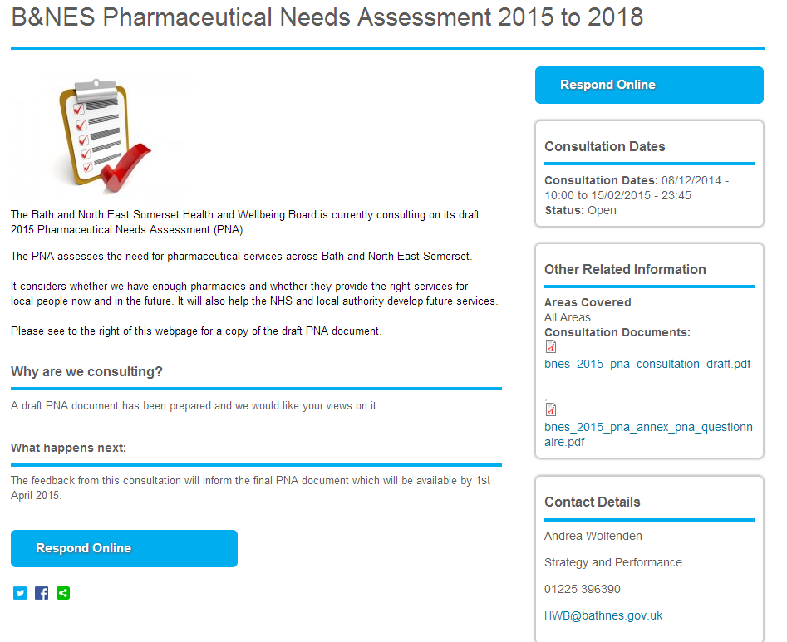
http://www.bathnes.gov.uk/consultations/bnes-pharmaceutical-needs-assessment-2015
Notes:
These figures are 2006/07 annual estimated costs of alcohol to the NHS from DOH (£2.7 billion) – Government alcohol strategy 2012 – estimated costs to society as whole £21 billion
56% spent on frontline inpatient and outpatient hospital treatment
Problem drinkers consult GP twice as often as the average patient
Prescriptions dispensed to treat alcohol dependency in England have increased by almost 75 per cent in nine years – now costs nearly £3 million annually compared to £1.7 mill in 2003
Estimated cost to society locally is:
In B&NES £3.2 m in Drug & alcohol treatment services
We estimate that up to £5.0 million is spent yearly on health care for alcohol-use disorders in B&NES
We estimate up to £18.7 million is lost yearly due to the economic output reduction caused by alcohol-use disorders in B&NES
The total cost in B&NES of the harm arising from alcohol-use disorders is some £45.0 million a year - includes £21 million costs of crime.

Slide 17
Questions
For a full list of consultation questions see website
Do you agree, or have any comments on, Key Finding 5 “around a quarter of community pharmacies that have a consultation room/area do not currently have wheelchair access”?
Are you aware of any other barriers (e.g. sensory impairment, language, transport etc) for the local population in accessing pharmaceutical services?
Are there any gaps in the range of services for those people with ‘protected characteristics’ (2010 Equality Act)?
Are there any community safety issues relating to pharmacy?
Notes:
These figures are 2006/07 annual estimated costs of alcohol to the NHS from DOH (£2.7 billion) – Government alcohol strategy 2012 – estimated costs to society as whole £21 billion
56% spent on frontline inpatient and outpatient hospital treatment
Problem drinkers consult GP twice as often as the average patient
Prescriptions dispensed to treat alcohol dependency in England have increased by almost 75 per cent in nine years – now costs nearly £3 million annually compared to £1.7 mill in 2003
Estimated cost to society locally is:
In B&NES £3.2 m in Drug & alcohol treatment services
We estimate that up to £5.0 million is spent yearly on health care for alcohol-use disorders in B&NES
We estimate up to £18.7 million is lost yearly due to the economic output reduction caused by alcohol-use disorders in B&NES
The total cost in B&NES of the harm arising from alcohol-use disorders is some £45.0 million a year - includes £21 million costs of crime.

Slide 18
Next steps…
Consultation closes 15th February
PNA approved by Health and Wellbeing Board 25th March 2015
PNA used to judge future requests to expand existing or add new pharmaceutical services
Thank you for your time today

