Slide 1
Student Accommodation in Bath -The B&NES Placemaking Plan-
Bath City Forum
21st January 2016

Slide 2
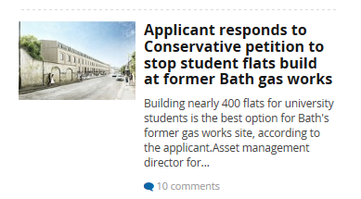

Slide 3
THE EVIDENCE

Slide 4
The current approach
Growth forecasts were lower than the rates prior to 2011
Around another 2,400 bedspaces were needed by 2020
Student accommodation needs could be met alongside the city’s other development requirements (a combination of on-campus development, with some off-campus development) and without increase of student HMOs to.
HMO article 4 direction
Notes:
CS prepared 2013/14
Published forecasts of both institutions lower

Slide 5
HMOs in Bath
<10%
<15%
<20%
<25%
>25%
Notes:
has the highest concentration of fulltime Higher
Education (HE) students (HESA data), after Oxford. Moreover, unlike
Oxford, it does not have the dedicated student residences of a long
established college system, and the multiple Oxford Brookes campus
locations are less constrained than either Claverton Down or Newton Park.
Student HMOs as a proportion of the dwelling stock are therefore very high,
more so than in Oxford.

Slide 6
Updated evidence on growth aspirations
5,300 more students (2011/12 to 2020/21) equates to around 4,700 more bed spaces
4,500 more FTEs (2011/12 to 2020/21) equates to around 3,800 more bedspaces
Combined Picture: 8,500 more bedspaces 2011 – 2021
Notes:
Data compatibility
Issue for further consideration
Bath 14,000 – 19,300 students = 10,300 – 15,000 bedsapces

Slide 7
SUPPLY OF STUDENT ACCOMMODATION

Slide 8
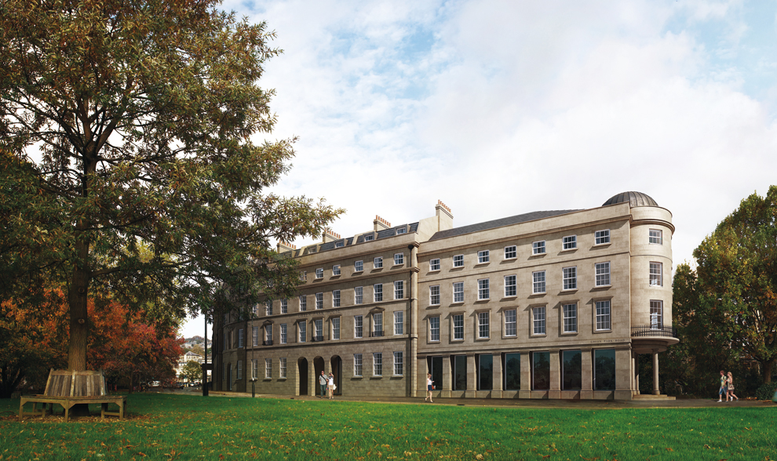
Supply of student accommodation
New supply (on and off-campus) that has been built since 2011, is under construction, outstanding permissions and campus capacity = 3,569 (1,985 UoB and 1,585 for BSU)
Residual need of around 4,900 bedrooms (around 2,700 for UoB and 2,300 for BSU)
Growth to 2029?
Notes:
That is equivalent to a need for: • around 1,225 HMOs to September 2020, or if that is to be avoided
• around 11 more city centre type Green Park House developments (461 beds in 13,500 m2. i.e. 148,500 sq.m. overall) or ,
• around 15 more out-of-centre type Twerton Mill Developments (327 beds on 8,700 m2. i.e. 130,000 m2. overall)
• that is an opportunity cost of around 1,700-1950 normal apartments or 60,000 sq m of office space and 900-1,150 apartments, and the affordable housing component which could be secured within that.

Slide 9
Supply

Slide 10
Other land-use demands in Bath
around 60,000 – 70,000 m2 of new office floorspace.
Retail - around another Southgate.
housing – around another Keynsham
Hotel – 5 more Apex hotels.
student accommodation - broadly equivalent to 11 new Green Park Houses
Notes:
around 60,000 – 70,000 m2 of new office floorspace.
• projected capacity for approx. 30,000 m2 of comparison retail up until 2029.
• around 7,000 dwellings in Bath (Core Strategy), of which around 3,300 dwellings are in the Enterprise Area.
• demand for between 931 and 1607 new hotel bedspaces by 2030, probably within the Central Area. Spatially, and to only meet the lowest capacity, this is broadly equivalent to five more Apex hotels.
• very significant demand for new student accommodation arising from revised university expansion plans. This is broadly equivalent to 11 new Green Park Houses or 150,000 m2 of floorspace (see separate paper). Add equivalents

Slide 11
Bath – a World Heritage site
Notes:
a whole suite of demands on a highly constrained city, which is a relatively small as a host for two universities and which has a limited land supply for meeting all development needs in full (see Table 1 below). Thus, difficult choices need

Slide 12
THE STRATEGY

Slide 13
The proposed approach
Notes:
statutory plan
Full weight in decisions

Slide 14
Examination – is the plan sound?
positively prepared –meet objectively assessed needs for development
justified –the most appropriate strategy, when considered against the reasonable alternatives;
effective – the plan is deliverable;
consistent with national policy – delivery of sustainable development.
Notes:
Nppf meet full needs

Slide 15
Council’s corporate aspirations

Slide 16
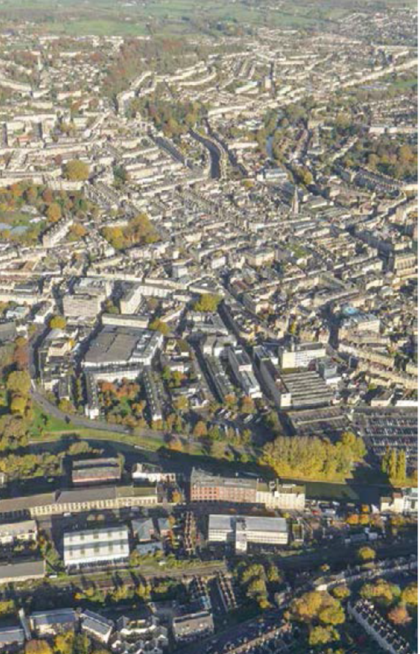
The strategy in the Placemaking Plan
Realise a sustainable balance between;
enabling the Universities to fulfil their ambitions, as far as possible,
the concerns of communities
the overall functioning, performance and environmental quality of the city and its setting.
the realisation of the wider objectives for the city,
A negative impact on the existing housing stock of the city
Notes:
The Council still seeks to enable, as far as possible, the continued success of The UoB and BSU and the contribution they make to the city’s identity, profile and employment base, and their a wider contribution to the UK skilled workforce and GVA. The provision of student accommodation is a high priority for the Universities and the Council also understands that each institution aspires to invest in and spread its academic and administrative estate in order to continue to provide high standards, in what is becoming an increasingly competitive higher education market. The Council is also aware Governments Higher Education Green Paper (November 2015).
however

Slide 17
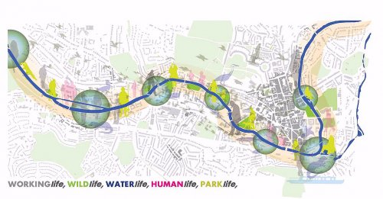
Key elements
Identify key sites for development to meet objectives – land use mix specified
Maximise provision on campuses
Restrain HMO growth (Article 4 Direction + SPD)
Scope for some off-campus growth
Design & amenity policies
Notes:
considered additional measures/policies such as refusing teaching space when dedicated accommodation supply is generating a need for more than a certain number of HMO bedrooms. Such an approach is in place in Oxford, but it is not considered to be a tool to be deployed yet in Bath as new teaching space is not only about enabling growth but improving existing conditions, there is not an equivalent B5 policy in Oxford, and both Oxford Universities have more land ownership options. Such a mechanism will though remain an option for future plan reviews.

Slide 18
Policy B5: Strategic policy for universities & private colleges
Overall Approach
Planning decisions should enable, as far as possible, the aspirations of the University of Bath and Bath Spa University to be met, within the context of environmental sustainability and the need to deliver the full spectrum of other development requirements for the city, in the city.
Off-campus Student Accommodation and Teaching Space
Proposals for off-campus student accommodation (whether in the form C2, C4 or sui generis residential units) or teaching space will be refused within the Central Area and the Enterprise Area where this would adversely affect the realisation of the vision and spatial strategy for delivering housing, and economic development (in respect of office, industrial, retail and hotel space).
Housing Market Impacts.
Between 2011 and full Plan review the number of C3 dwellings permitted to convert to (Class ‘N’ Council tax exempt) C4 Houses in Multiple Occupation will be monitored and compensatory provision will be made if the achievement for 7,000 net additional dwellings for the city is at risk.

Slide 19
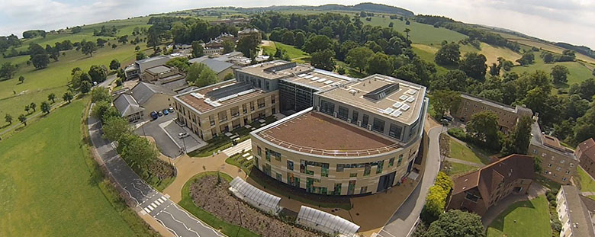
On-Campus development
POLICY SB19 University of Bath
SB20 - Bath Spa University
at Newton Park
Notes:
Site allocations polices
The UoB has the scope to utilise land that was removed from the Green Belt in 2007, together with land within the core parts of the campus to enable it to achieve its aspirations for growth (in terms both of student accommodation and academic space)
BSU has less control over its future
Other GB release?

Slide 20
Next steps
Draft Plan
Jan 2016
March 2016
Summer 2016
Autumn 2016
Winter 2016
submission
Hearings
Examination
Report
Adopt
Notes:
Consider new evidence
Present case to inspector & revised evidence base

Slide 21
Background

