Slide 1
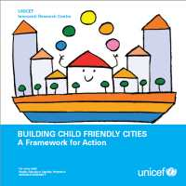
Bath and North East Somerset as a Child Friendly City and Community
The Story So Far
Children shape our cities, and our cities shape our children
Children are the future

Slide 2
9 building blocks to become a child friendly city:
1. Ensure children’s participation
2. Have a child friendly legal framework
3. Develop a city-wide children’s engagement strategy
4. Create a children’s rights unit or a coordinating mechanism
5. Ensure a child impact assessment and evaluation
6. Have an appropriate children’s budget
7. Ensure a regular state of the city’s children report
8. Make children’s rights known among adults and children
9. Support independent advocacy for children

Slide 3
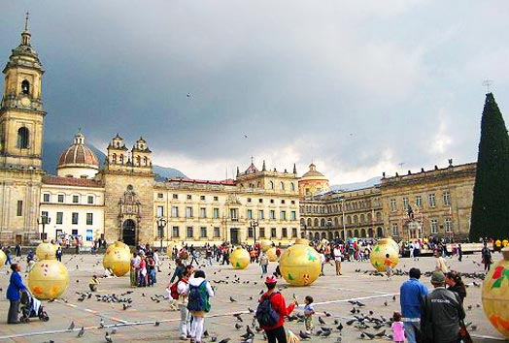
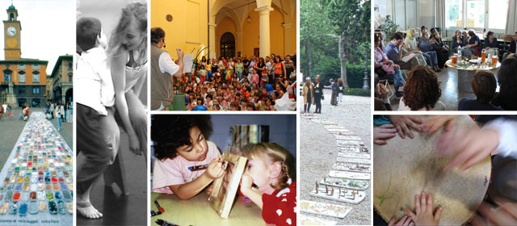
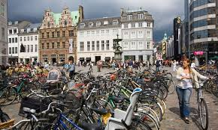
If a city is successful for children, then it will be successful for all people

Slide 4
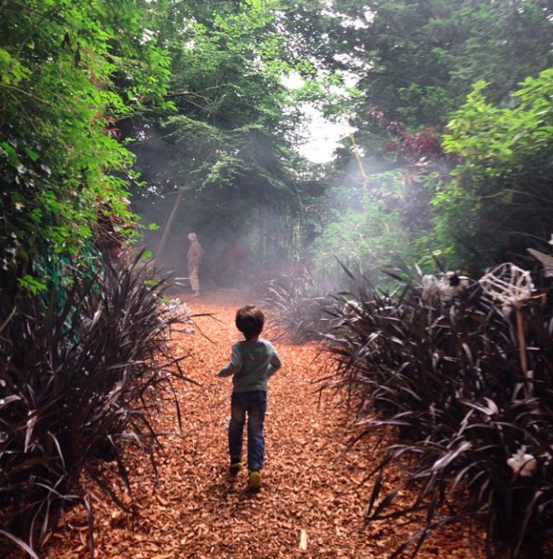
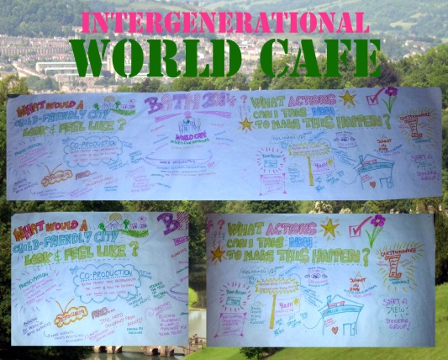
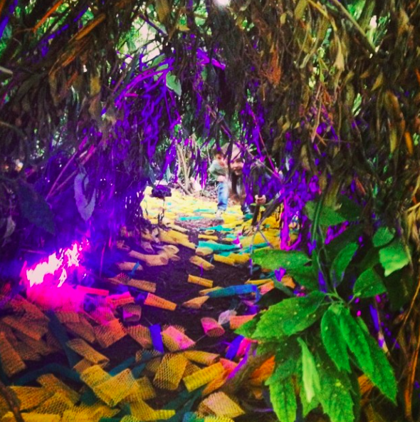
B&NES CFC Journey
Since 2013 the Bath CFC initiative has been driven by cultural and educational organisations: 5x5x5=creativity, Cultural Forum, the egg theatre, Mentoring Plus, Young Carers, Bath Spa University and local schools
Launch event with RSA Kickstarter Crowdsourcing September 2013
Forest of Imagination 2014 - now an annual event
CFC statement to B&NES Cabinet July 2014
Proposal for CFC Project Manager sent to B&NES Council 2014
Intergenerational event with children and young people October 2014
Glow exhibition at 44AD March 2015
Sir Ken Robinson endorsement June 2015

Slide 5
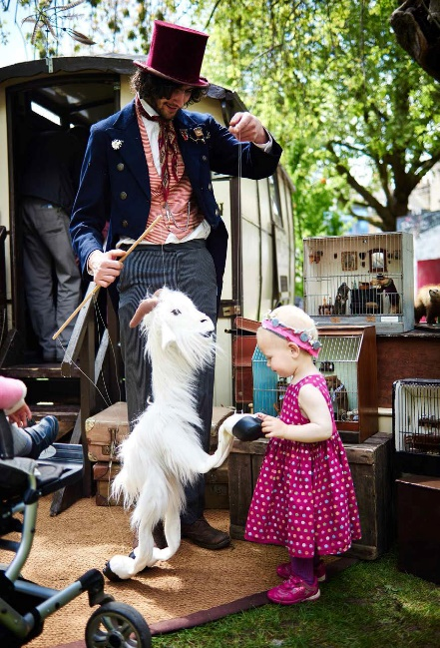
The story so far includes
Exemplary projects
Ongoing consultation with children and young people
Meetings with MP, Councillors and potential partners
Global Goals launch September 2015
Presentation to Scrutiny Panel for Children and Young People September 2015 and 2016
Child Friendly City events 2016
Proposed International Festival of Childhood 2017 with Save Childhood Movement

Slide 6
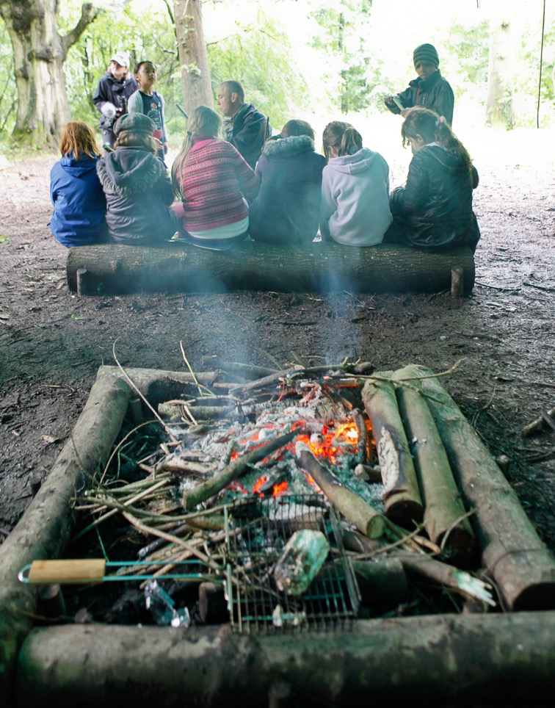
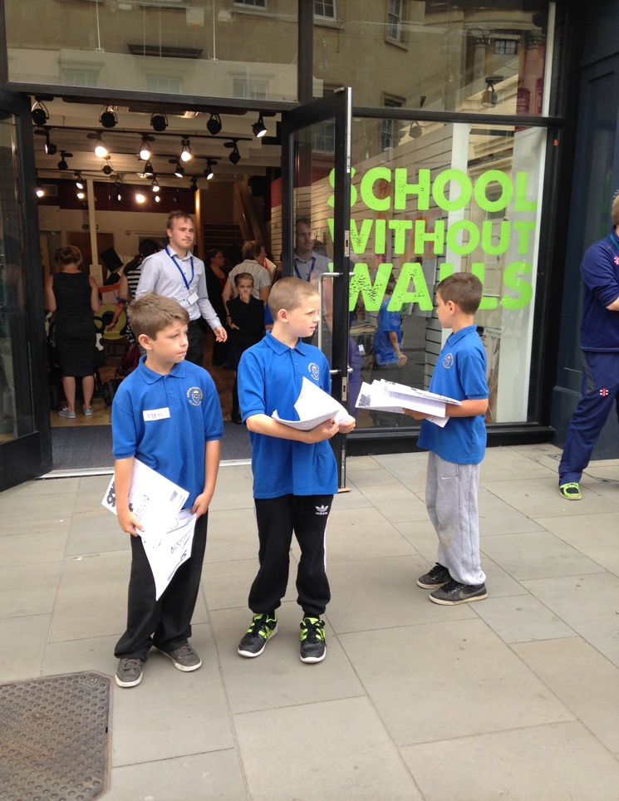
Notes:
children as collaborators not consumers
participation is key

Slide 7
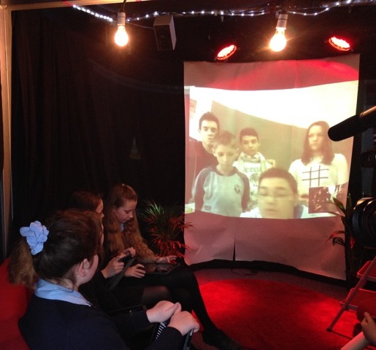
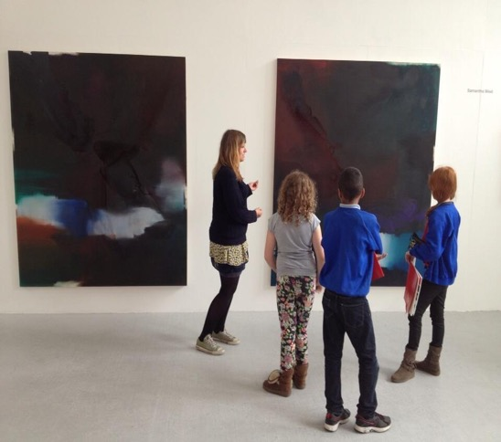
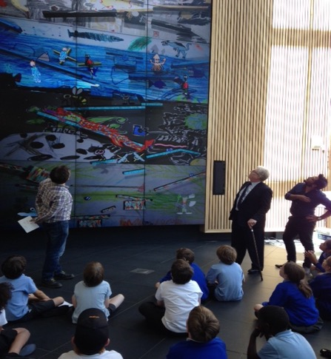
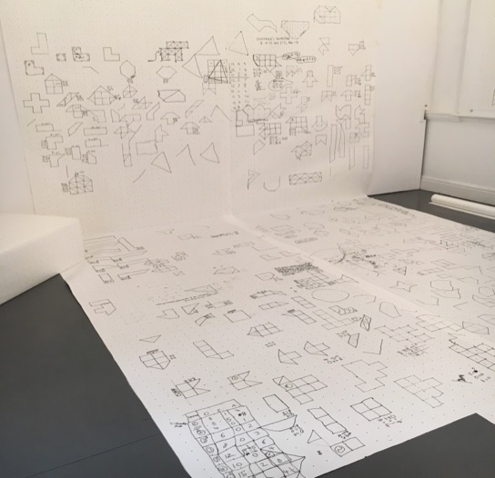
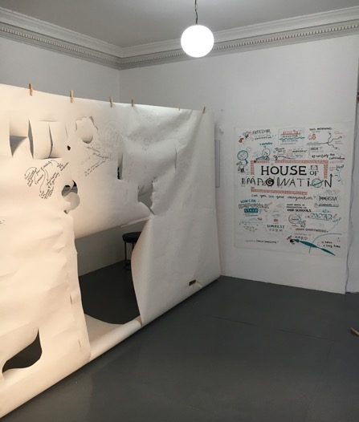

Slide 8
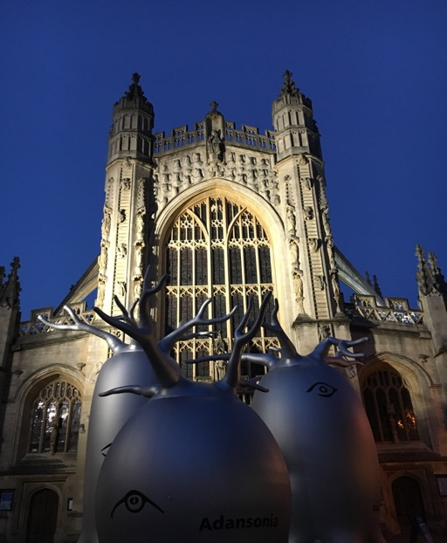

Slide 9
B&NES Child / Youth Friendly City and Community
All children and young people’s educational achievement
and access to social, cultural, creative
and community resources

Slide 10
Our Action Plan
Produce a C&YP-led B&NES Child Friendly Community (BCFC) Manifesto
Secure two-year funding for a BCFC Project
Co-ordinator to deliver the Manifesto and UNICEF CFC Child Rights status
Include C&YP from across B&NES, to include: primary, secondary, In Care, Young Carers, SEN and those disengaged from education or with chronic health needs

Slide 11
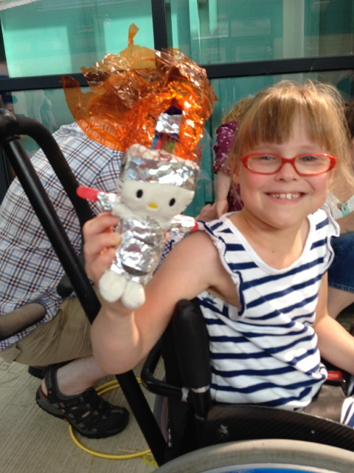
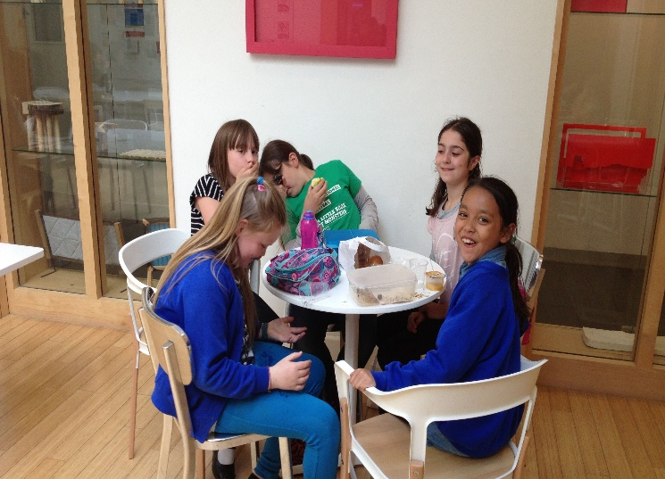
Visit our blog for more examples of work undertaken by members of the steering group
https://childfriendlycity.wordpress.com
Children and young people are responsible, active and model citizens

Slide 12
CHILD RIGHTS PARTNERS
Putting children’s rights at the heart of public services

Slide 13
UNICEF MANDATE
Convention on the Rights of the Child
“Realizing the rights of every child, especially the most disadvantaged”

Slide 14
CRP & CHILD FRIENDLY CITIES
Child Friendly Cities (CFC)
Global Unicef programme (over 30 countries)
Partnership between Unicef & cities/municipalities
Embedding children’s rights in policies, laws, programme and budgets.
CFC pilot & evaluation in the UK:
Need for a greater focus on outcomes
Need for more robust evidence base
Need for context specific approaches & solutions
Child Rights Partners

Slide 15
ABOUT CHILD RIGHTS PARTNERS
Child Rights Partners brings together Unicef UK and local government to put children’s rights at the heart of public services and ensure all children have the same opportunity to flourish.

Slide 16
HOW UNICEF WORKS WITH LAs:
Approach, methods and tools:
Close collaboration with LAs & partners
Local and contextualised solutions
Spotlighting & building on good practice
Transforming the whole system
Training, capacity building, technical assistance & mentoring
Child Rights Outcomes Framework

Slide 17
THE ADDED VALUE & IMPACT
A child rights-based approach
Impact on
People
Culture
System
Outcomes
When local authorities take a child rights-based approach,
children:
Know and understand their rights
Know about the services available and how to access them
Have a say in the design and delivery of services
Experiences connected, tailored and responsive services
Feel safe, nurtured, prioritised and are treated with dignity
Professionals tell us a child rights-based approach:
Creates a shared language, a sense of collective effort & provides a common reference point
Allows for a greater focus on outcomes
Provides a robust framework for effectively placing the child/young person at the centre of thinking and practice

Slide 18
