Slide 1
Open Studio Consultation Report
Completed by Bethany Mitchell
29th June 2016

Slide 2
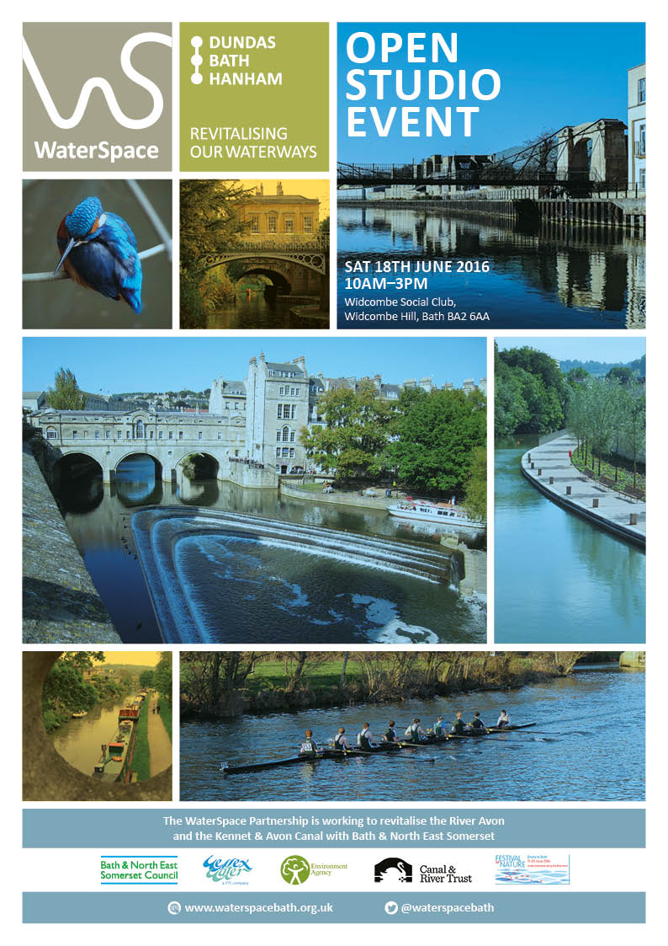
The Open Studio was an all-day event on Saturday 18 June at Widcombe Social Club in Bath.
B&NES and Atkins staff was both in attendance on behalf of the partnership.
This was an opportunity to show work in progress on maps. A giant map of the Enterprise area in Bath and information from the Regeneration team was also provided. The day included other information such as a collage of ideas for the Water Space Study and ideas from a London Study trip and similar strategies.
This event was advertised throughout the Festival of Nature and posters were distributed around Bath. Approximately 400 people were invited and around 65 people attended, most staying for 30 minutes or longer.
The public were invited to make comments via post it notes on the maps and feedback on WaterSpace cards.
Feedback regarding the event was very positive.

Slide 3
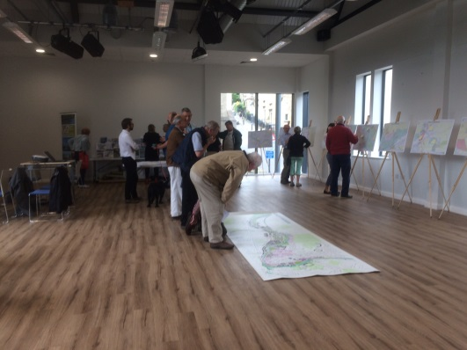
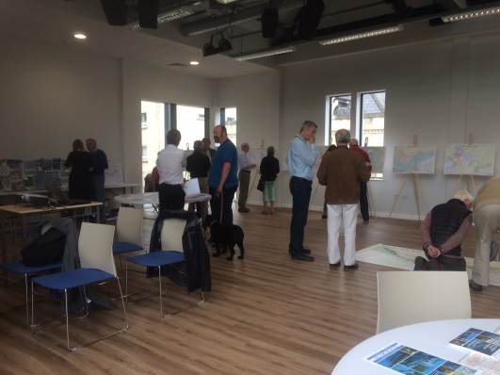
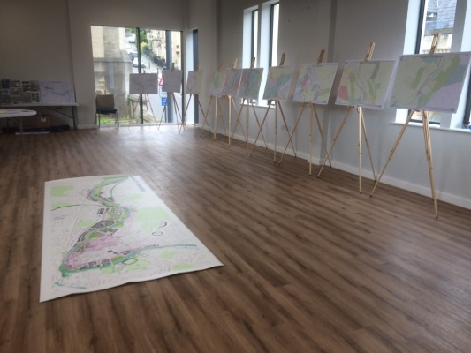
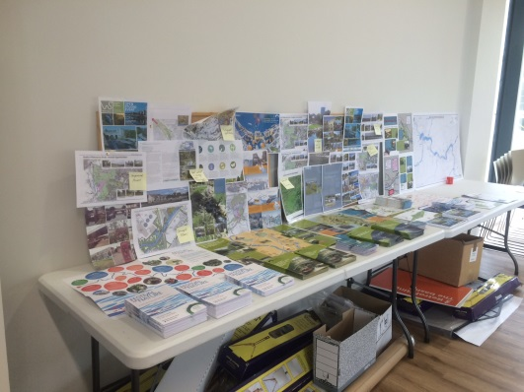
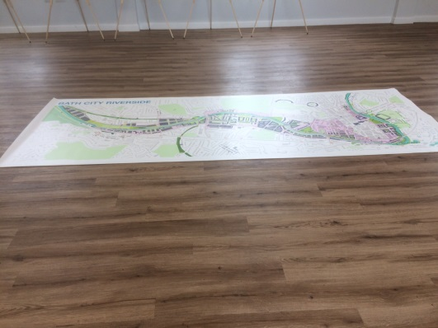
“Excellent Presentation” Cllr Goodman
“Really good to see you and an enthusiastic Water Space team on Saturday. A super exhibition” Peter Fear, Bathampton
A number of people expressed interest in waterways related volunteering opportunities in the area (feature to be added to July newsletter).

Slide 4
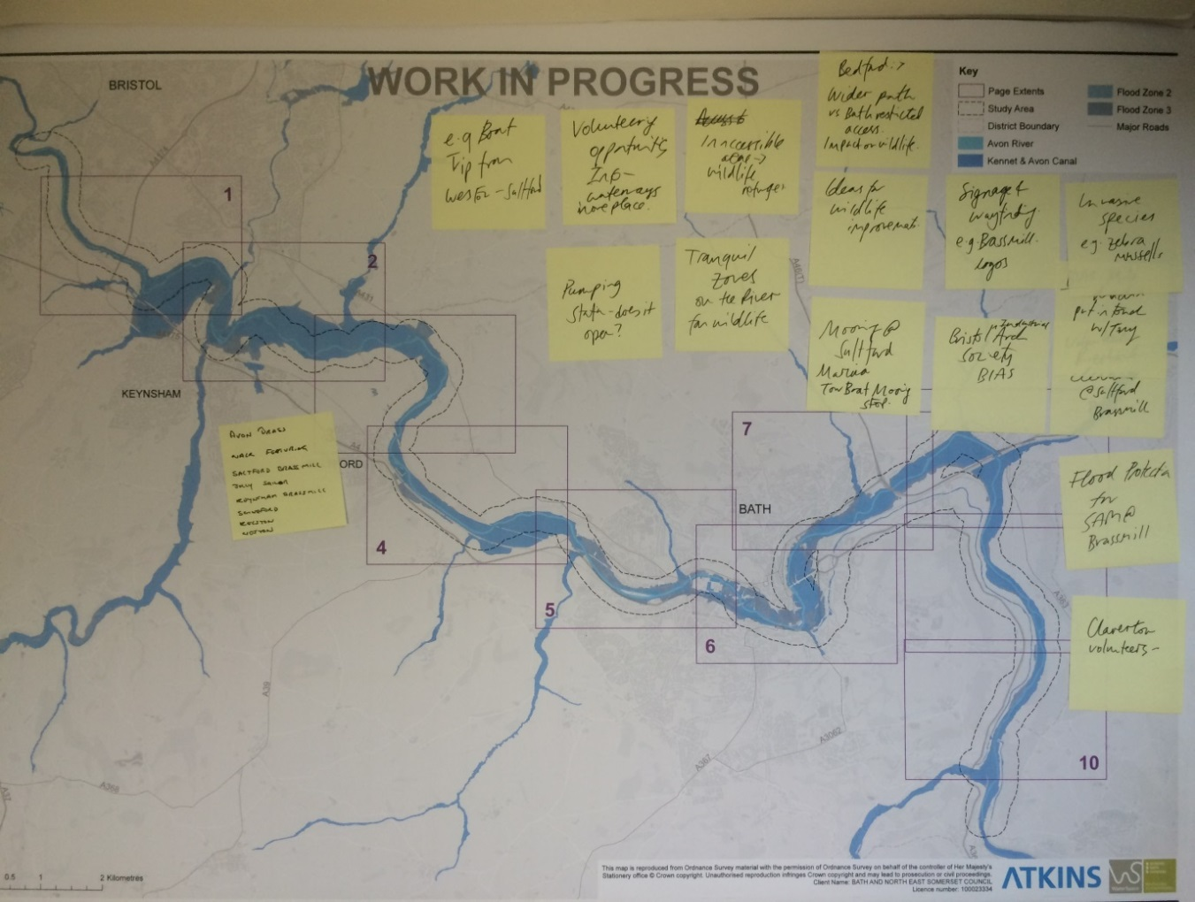
Avon Brass, Walk Featuring Saltford Brass Mill, Jolly Sailor, Keynsham Brassmill, Swineford, Kelston, Weston
E.g boat trip from Weston – Saltford
Volunteering opportunities
Pumping station – does it open?
Inaccessible – wildlife refuges
Tranquil Zones on the river for wildlife
Bedford: Wider path vs bath restricted access. Impact on wildlife
Ideas for wildlife improvement
Mooring @ Saltford Marina
Signage of wayfinding e.g: Brassmill logos
Bristol Industrial Arch Society bias
Claverton Volunteers
Flood Protection for Brassmill
Volunteers –Riverbranch clearance at Saltford Brassmill

Slide 5
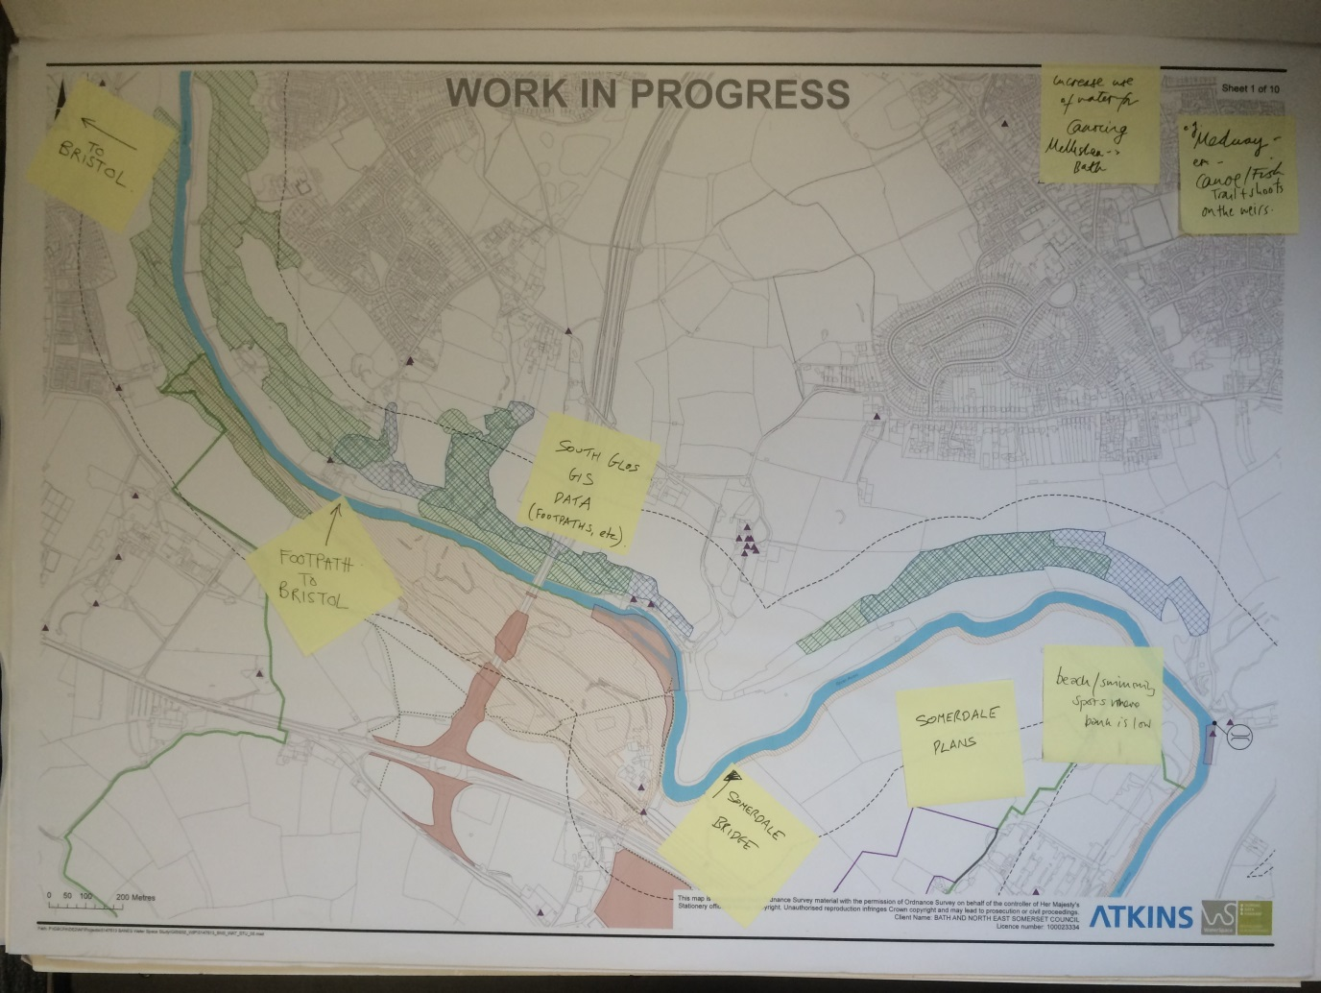
Board 1 of 10
To Bristol
Footpath to Bristol
South Glos GIS Data (footpaths etc)
Somerdale Bridge
Somerdale Plans
Beach/swimming sports where branch is low
Increase use of waterfalls, canoeing Melksham to Bath
Canoe/Fish traits & shorts on the weir’s

Slide 6
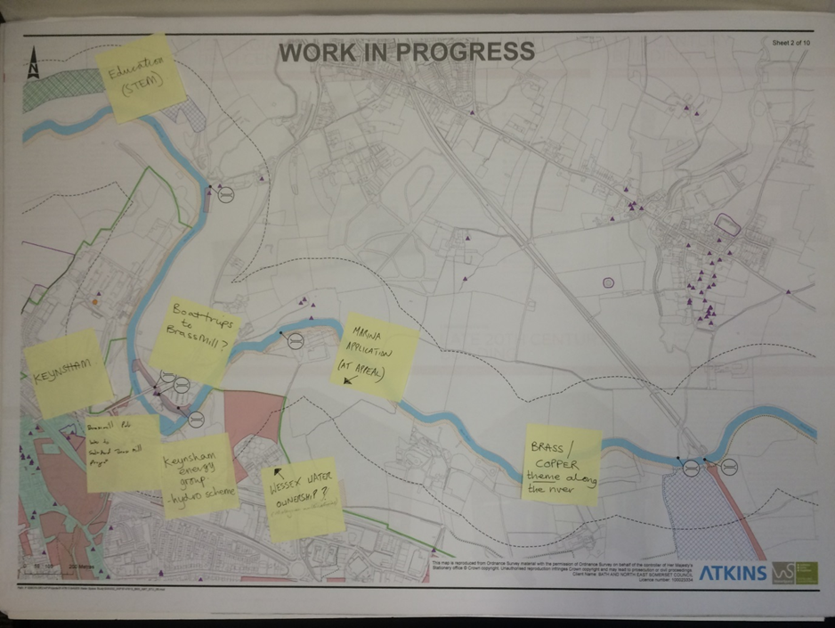
Board 2 of 10
Education (STEM)
Keynsham
Boat trips to Brassmill
Brassmill pub into Saltford Brassmill
Keynsham energy group – hydro scheme
Wessex Water Ownership?
Marina Application
Brass/Copper theme along the river

Slide 7
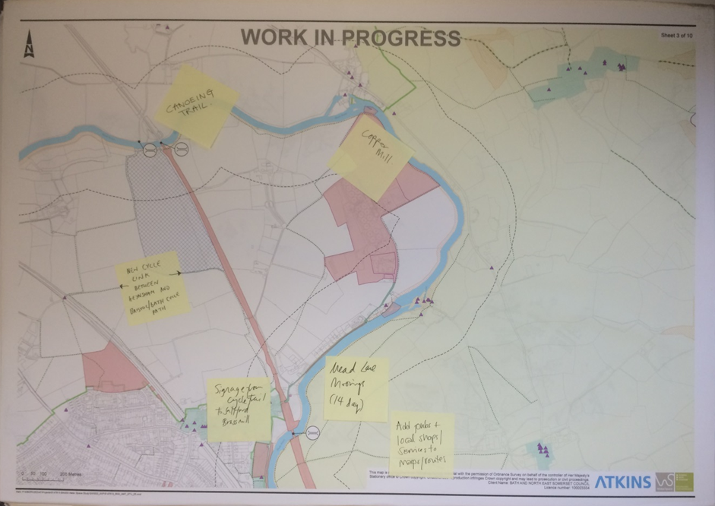
Board 3 of 10
Canoeing Trail
New cycle link between Kenysham and Bristol / bath cycle path
Signage from cycle trail to Saltford Brassmill
Mead Lane moorings (14 Day)
Add pubs & local shops to map routes
Copper Mill

Slide 8
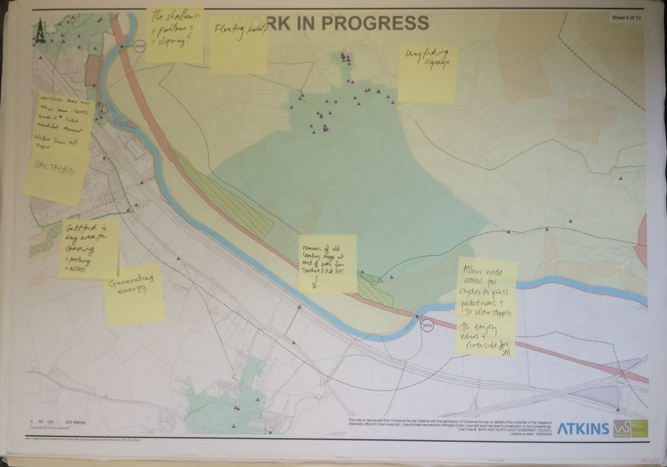
Board 4 of 10
Saltford
Saltford Brass mill – leave grade ii listed scheduled moorings
Saltford is key area for covering
Generating energy
The shallows
Floating
Remains of old landing stage at end of path from stothert of pit RFC
Wayfinding Signage
Allow wide areas for cycles to pass pedestrians to allow stopping to enjoy views & riverside

Slide 9
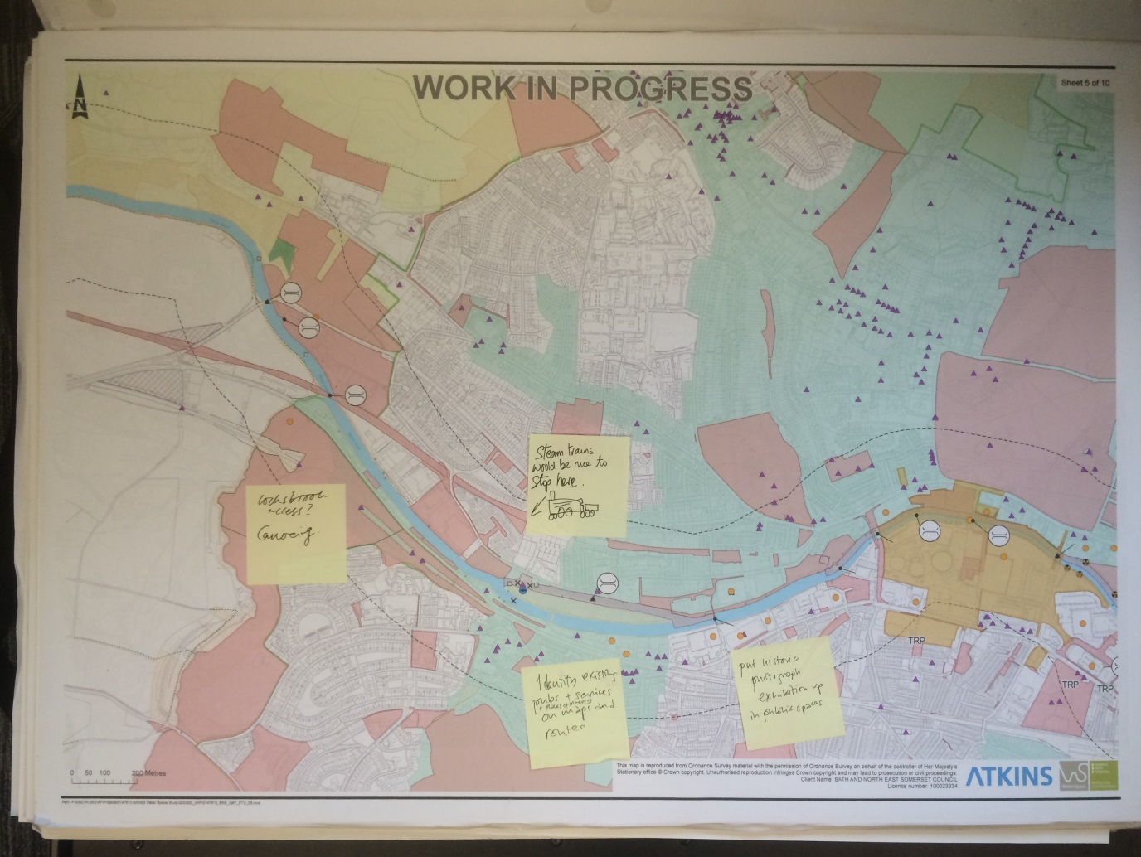
Board 5 of 10
Locksbrook access. Canoeing
Steam trains would be nice to stop here
Identify existing pubs and services / places of interest on maps and routes
Put historic photograph exhibition up in public spaces

Slide 10
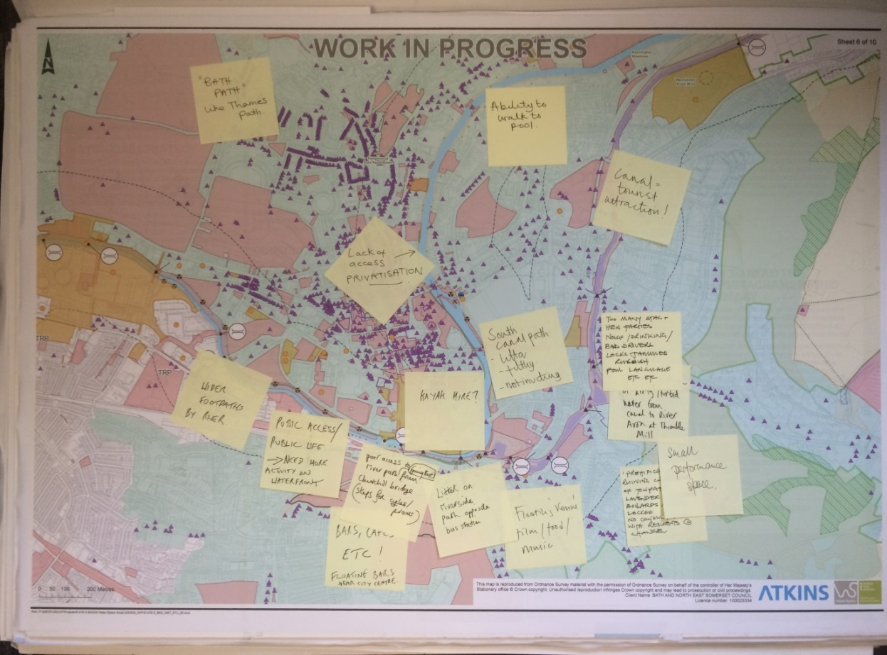
Board 6 of 10
’Bath Path’’ like Thames path
Lack of access privatisation
Ability to walk to pool
Canal tourist attraction
Wider footpaths by river
Public access / Public Life – Need home activity on waterfront
Poor access to river path from Churchill bridge
Bars, cafes etc! Floating bars near city centre
Litter on riverside path opposite bus station
Floating ‘’venues’’ film / food / music
Too many stag and hen parties. Noise / drinking / bad drivers / rubbish
Constant discharge of dirty / turbid water from canal to river Avon at thimble mill
Small performance space
‘Gentrification by boaters’’ is ruining character of towpath, no consultation with residents on change

Slide 11
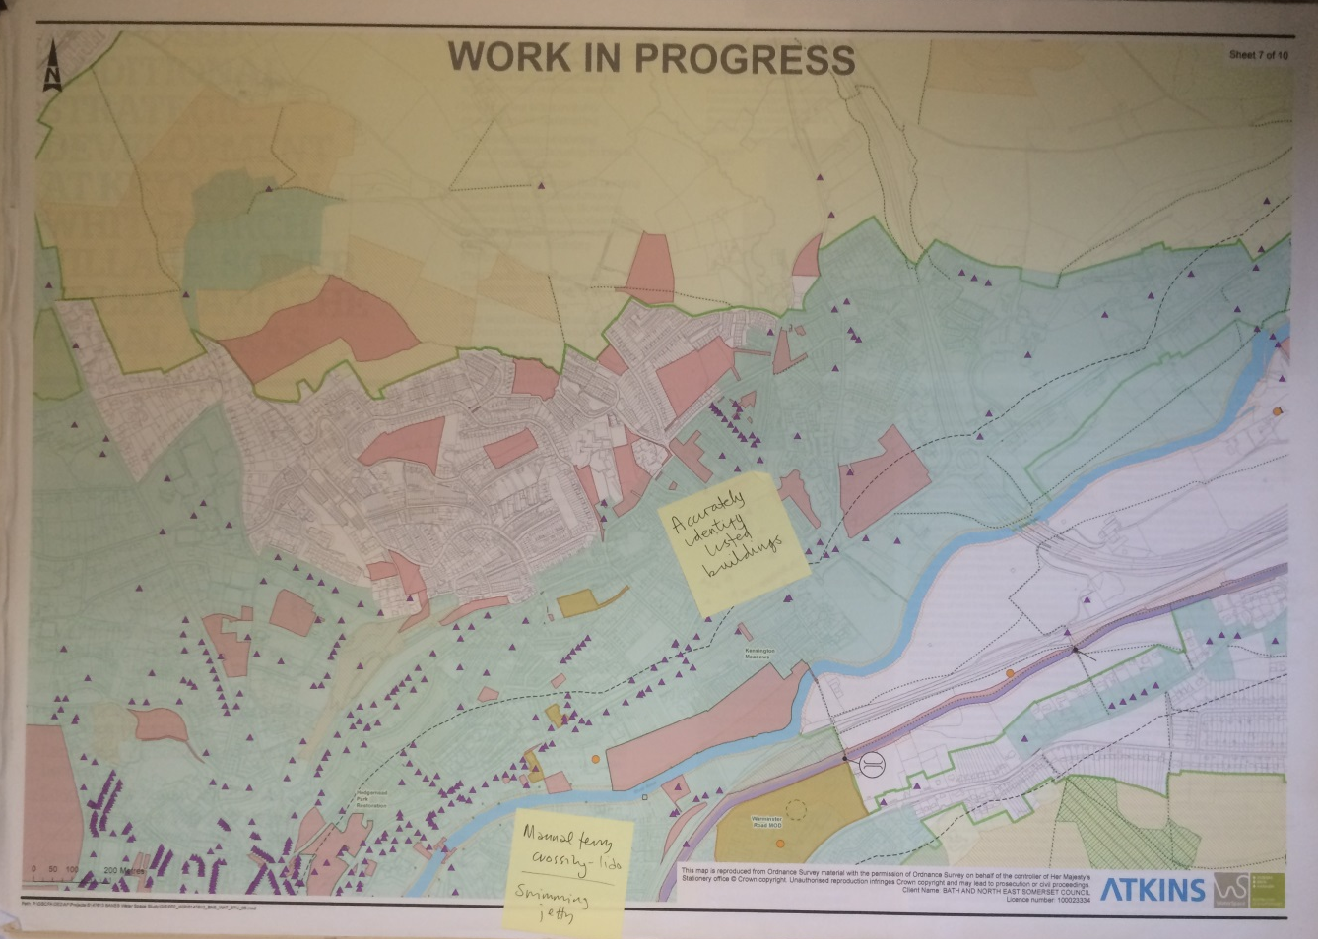
Board 7 of 10
Accurately identify listed buildings?
Manual ferry crossing

Slide 12
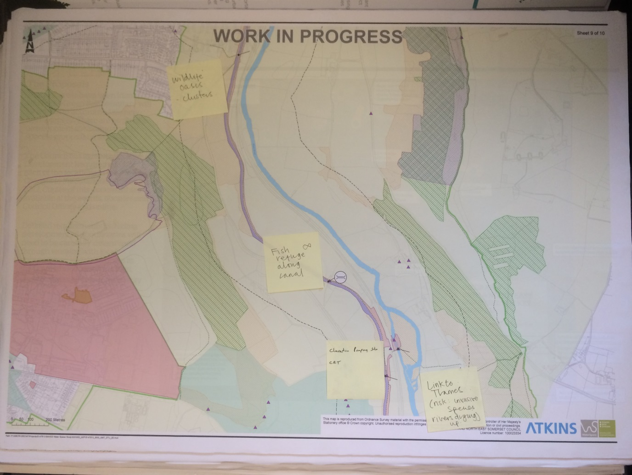
Board 8 of 10
Batheaston
Bathford
Affordable complying how impact Large area of un-used land with river frontage
Batheaston – warleigh weir
Batheaston
Upgrade to existing boat jetty
New bridge (prow and footpath)
Not a public footpath?
Safety improvements to mill lane to provide safe link between Avon & K&A

Slide 13
Board 9 of 10
Wildlife oasis – clusters
Fish refuge along canal
Claverton pumping station –CRT
Link to Thames (risk: rivers drying up)

Slide 14
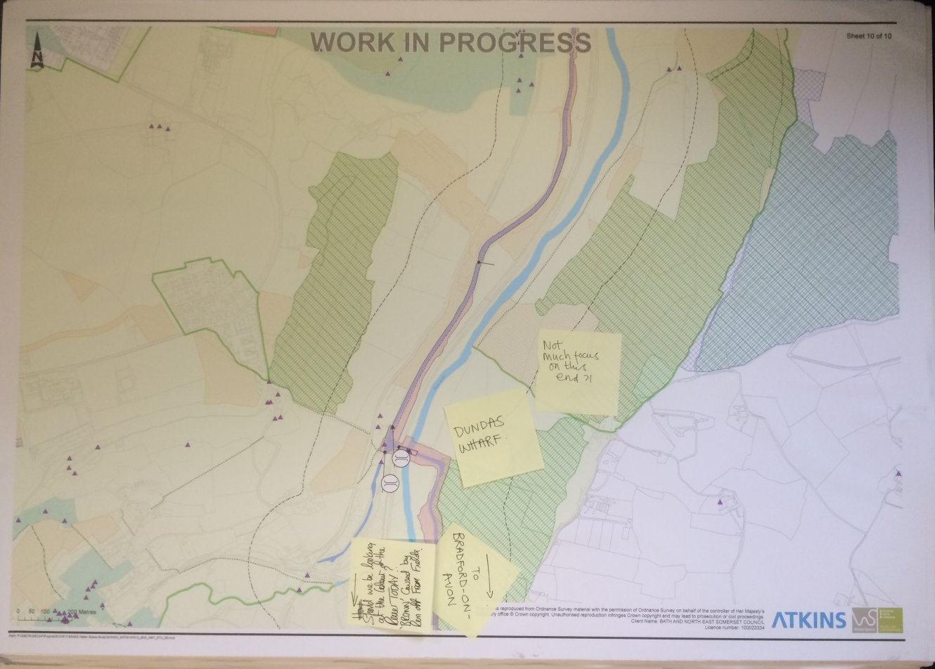
Board 10 of 10
Not much focus on this end?
Dundas Wharf
To Bradford on Avon
Should we be looking at colour of the river today? ‘’Brown’’ caused by run of from fields.

Slide 17
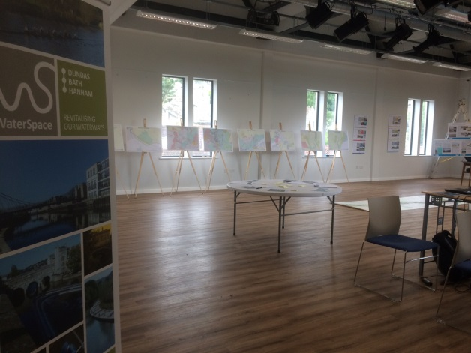
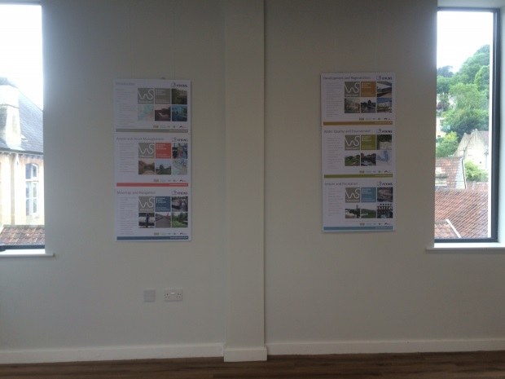
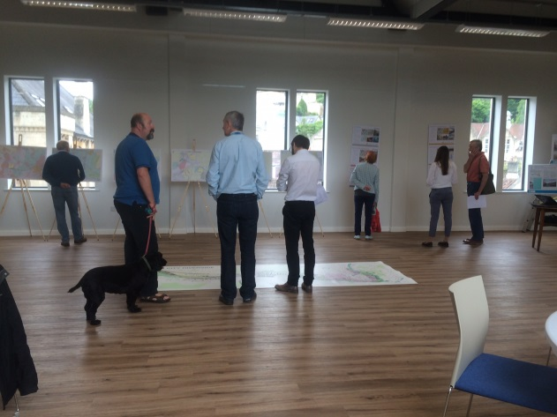
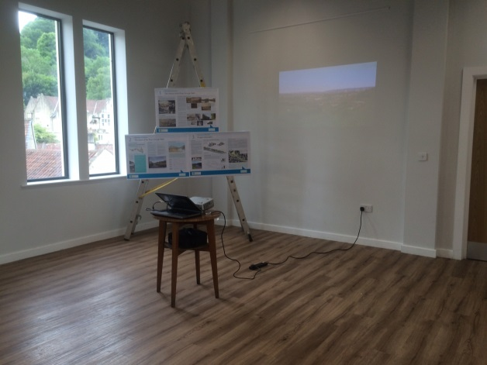
Thank you

