Slide 1
Member training and development
23 September 2015
Planning and Conservation Team

Slide 2
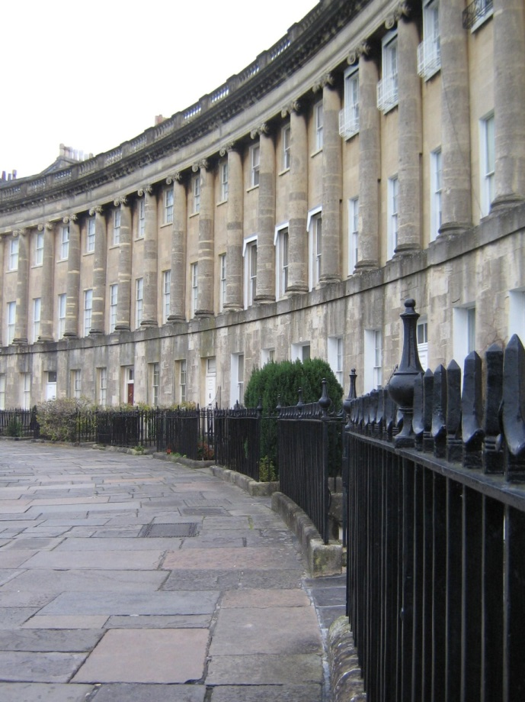
Outstanding Universal Values
World Heritage Site
Hot springs
Roman archaeology
Georgian architecture
Georgian town planning
Landscape setting
Georgian architecture
reflecting18th century social
ambitions

Slide 3
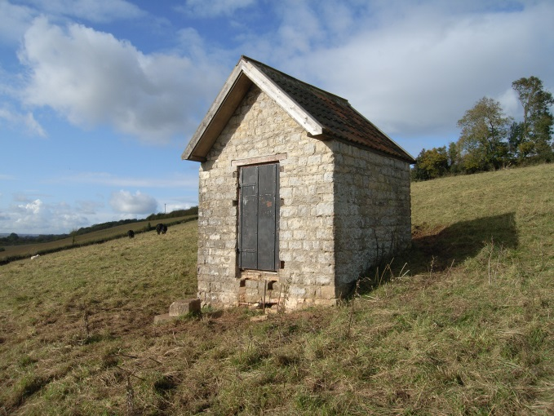
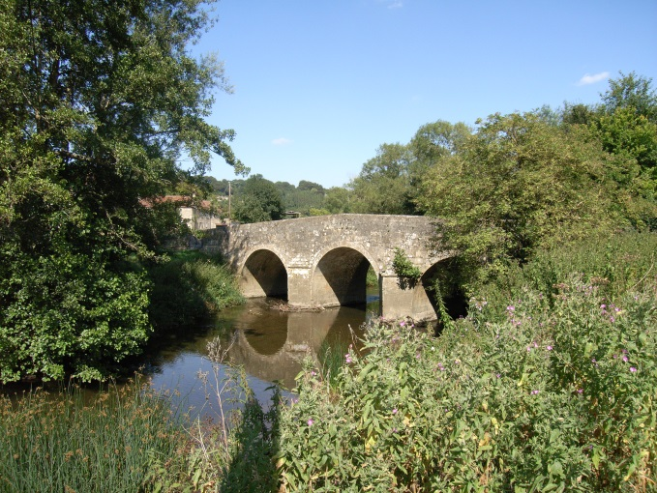
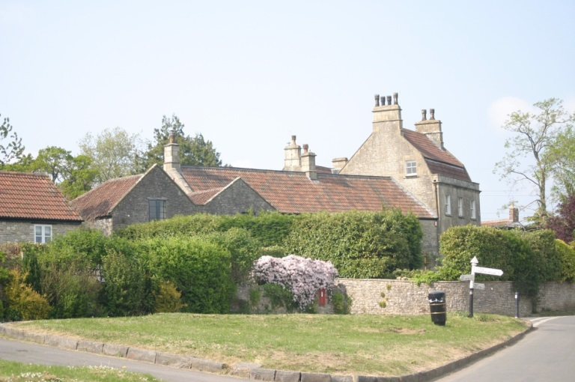
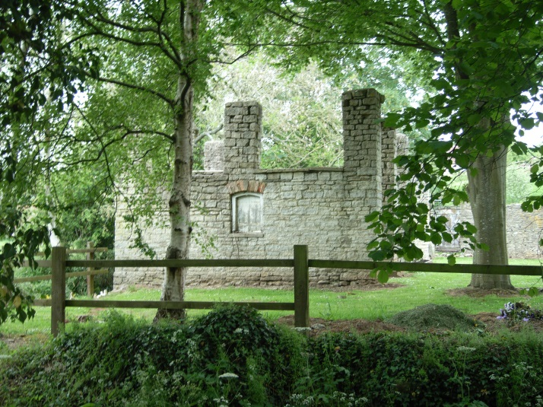
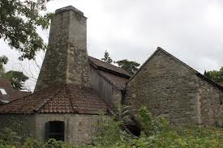
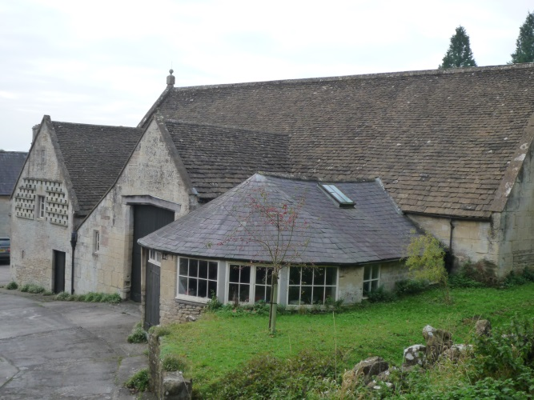
Rich and diverse historic environment

Slide 4
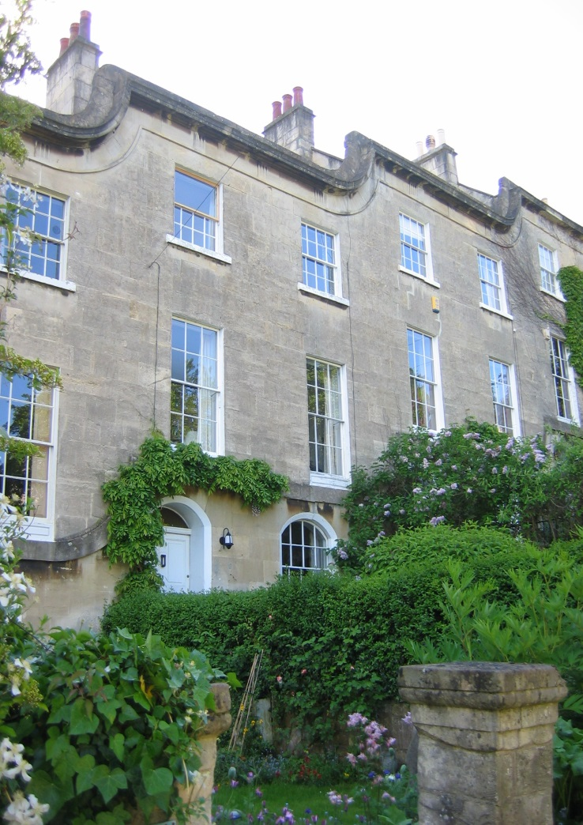
Heritage facts and figures
Over 6000 listed buildings
36 conservation areas
59 scheduled ancient monuments and more than 4000 recorded archaeological sites
16 registered historic parks and gardens
71 parks and gardens designated locally by the Avon Gardens Trust
Many undesignated heritage assets as well
St Mary’s buildings Bath

Slide 5
Planning and Conservation Team
Development management listed building applications, planning applications affecting listed buildings, archaeology and other heritage assets, major development in historic areas
Heritage at risk monitoring and action
Conservation areas appraisal and management
Advice and guidance building conservation, design, archaeology; advice within and beyond the Council
Historic Environment Record a wealth of information
Outreach getting communities involved
Historic environment policy framework for the future

Slide 6
Heritage values and significance
Caroline Waldron
Building conservation in Bath and North East Somerset
Adrian Neilson
Planning and Archaeology
Richard Sermon

