Slide 1
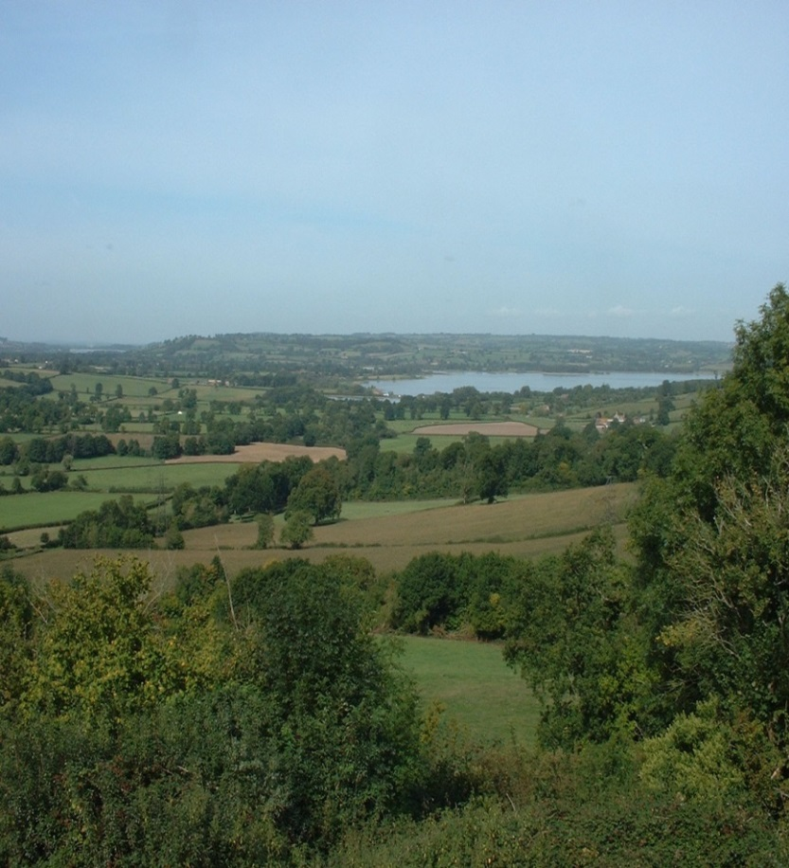
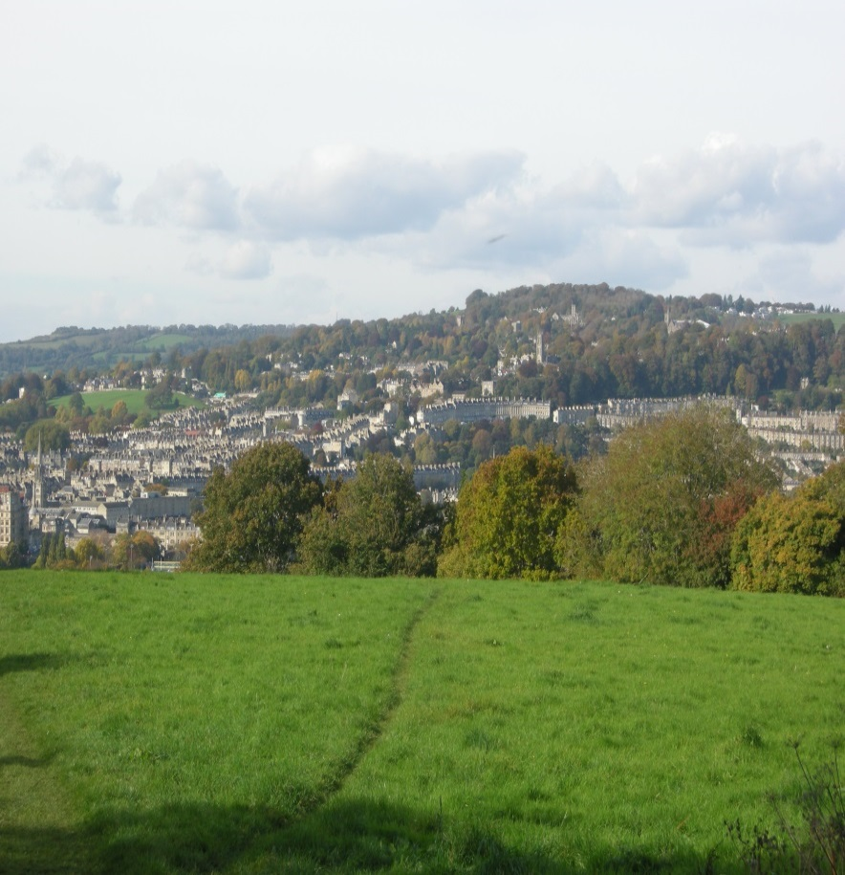
Members Training - Landscape and Trees Andrew Sharland – Senior Landscape Architect Jane Brewer – Senior Arboricultural Officer

Slide 2
Members Training – Managing our Landscape and Trees
Landscape
1 Why is landscape important?
2 Landscape policy
3 Landscape tools
4 What makes a good development?
Trees
1 Benefits
2 Tree protection
3 Trees and development
Questions

Slide 3
Members Training - Landscape
Why is landscape important?
European Landscape Convention
signed by the UK government in February 2006 - came into effect in March 2007
Key Principles
recognises that all landscapes are important
recognises the dynamic nature of landscape – with an emphasis on management of change, creating new landscapes as well as managing the landscapes that we inherit.

Slide 4
Members Training - Landscape
Why is landscape important?
European Landscape Convention
definition of landscape:
‘an area, as perceived by people, whose character is the result of the action and interaction of natural and / or human factors.’

Slide 5
Members Training - Landscape
Why is landscape important?
Everyone has a stake in the landscape
It forms the backdrop to our lives and is the stage set in which our lives are lived out
It provides the sense of place enabling people to belong to and value where they live
It is central to our quality of life where good design can be uplifting and provide the basis for healthy lifestyles
It provides a wide range of services such as water management

Slide 6
Members Training - Landscape
National Planning Policy Framework Landscape policy
Core Principle
‘Planning should - - - contribute to conserving and enhancing the natural environment’
Paragraph 109
‘the planning system should contribute to – protecting and enhancing valued landscapes’
Paragraph 170
‘where appropriate, landscape character assessments should – be prepared, integrated with assessment of HLC, and for areas where there are major expansion options, assessments of landscape sensitivity’.
‘planning should recognise the intrinsic character and beauty of the
countryside’

Slide 7
Members Training - Landscape
Landscape policy
D2 design and public realm | NE12 natural features
D4 townscape considerations | NE15 watercourses
NE1 Landscape character | GB2 amenity of the Green Belt
NE2 AONBs | BH6 effect on Conservation Areas
NE3 important hillsides | BH15 visually important open spaces
NE4 trees and woodland conservation
Core Strategy policy CP6
‘The distinctive character and quality of Bath and North East Somerset’s landscapes will be conserved or enhanced’

Slide 8
Members Training - Landscape
Landscape policy
Placemaking Plan - Policy NE2 1 ‘Development will be permitted where it:
A conserves or enhances local landscape character, landscape features and local distinctiveness
B incorporates green space within the scheme that positively contributes to creating a high quality environment by enhancing landscape character and biodiversity and providing sustainable public access and other landscape benefits
C is demonstrated that the whole scheme, including hard landscape and planting proposals, will contribute positively to the local area including reference to relevant existing landscape assessments supplemented by any additional assessments
D conserves or enhances important views particularly those to significant landmarks and features and take opportunities to create new local views and vistas.

Slide 9
Members Training - Landscape
Landscape policy
Placemaking Plan - Policy NE2
2 Development should seek to avoid or adequately mitigate any adverse impact on landscape.
3 Proposals with potential to impact on the landscape / townscape character of an area or on views should be accompanied by a Landscape and Visual Impact Assessment undertaken by a qualified practitioner to inform the design and location of any new development’.

Slide 10
Members Training - Landscape
Landscape policy
Supporting text in Placemaking Plan - Policy NE2
‘New development will be expected to reinforce the local landscape character and make a positive contribution to views.’

Slide 11
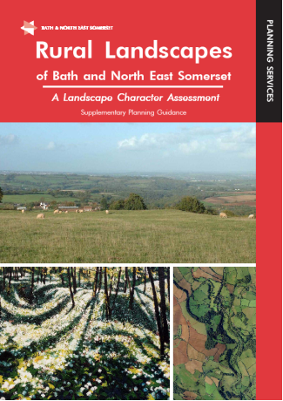
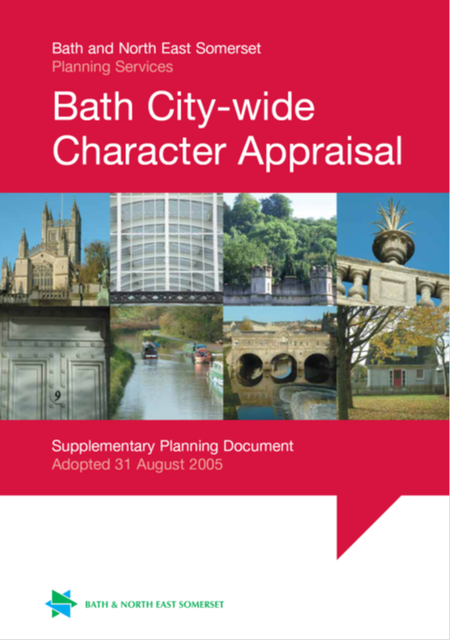
Members Training - Landscape
‘Applicants are expected to make full use of available guidance and documents including existing landscape character assessments and relevant planning guidance, management plans, conservation area appraisals and neighbourhood plans (see list at the end of the section).’
Supporting text in Placemaking Plan - Policy NE2
Landscape policy

Slide 12
Members Training - Landscape
The second part of the Placemaking Plan policy Landscape policy
NE2A
refers back to the
National Planning Policy Framework
Which states:
‘the planning system should contribute to – protecting and enhancing valued landscapes’

Slide 13
Members Training - Landscape
Landscape policy
Placemaking Plan Policy NE2A
‘Any development should seek to conserve and enhance the landscape setting of settlements and their landscape character, views and features. Development that would result in harm to the landscape setting of settlements will not be permitted.’

Slide 14
Members Training - Landscape
Landscape tools - - - Landscape Character Assessment
National Character Areas
107 Cotswolds
118 Bristol Avon Valleys and Ridges
141 Mendip Hills

Slide 15
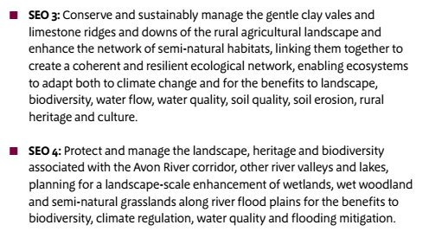
Members Training - Landscape
Landscape tools
Landscape Character Assessment
National Character Areas
118 Bristol Avon Valleys and Ridges

Slide 16
Members Training - Landscape
Landscape tools
‘I give considerable weight to the Council’s City of Bath World Heritage Site Setting Supplementary Planning Document (SPD). - - - The SPD contains much detailed analysis of the significance of the setting of the WHS around the City. ‘
Core Strategy Inspector’s Report - 24th June 2014
City of Bath World Heritage Site Setting SPD

Slide 17
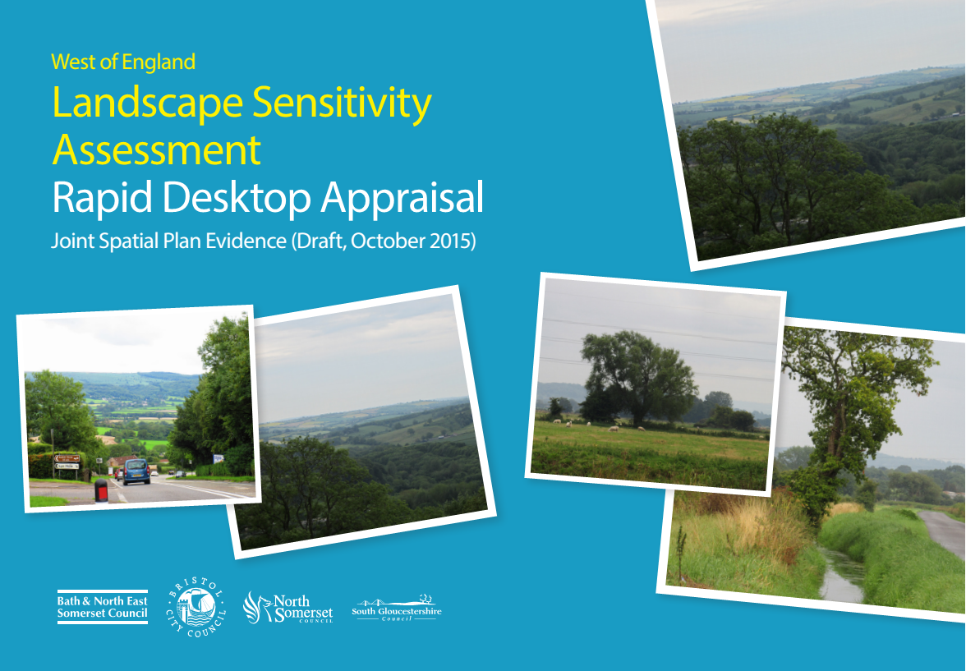
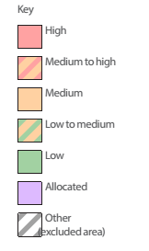
Members Training - Landscape
Landscape tools - - - Landscape Sensitivity Assessment
(Draft document due for publication in 2016)

Slide 18
Members Training - Landscape
Landscape tools - - -
Landscape and Visual Impact Assessment
Two separate assessments
Effects on landscape and views should be assessed for all schemes where there is a potential impact
Effect may be positive or negative

Slide 19
Members Training - Landscape
What makes a good development?
Planning Applications - - - what to look for
Effects on landscape character
Visual effects
Mitigation
Planning Conditions

Slide 20
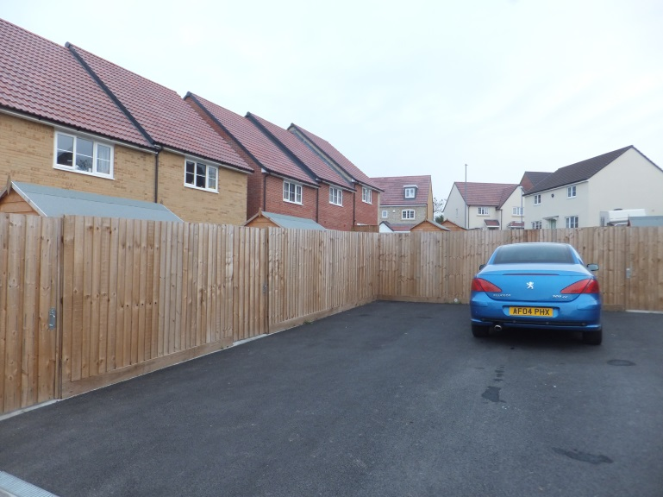
Members Training - Landscape
What makes a good development?
Recent housing development at Bishops Sutton

Slide 21
Members Training - Landscape
What makes a good development?
Housing at Broadmoor Lane, Weston

Slide 22
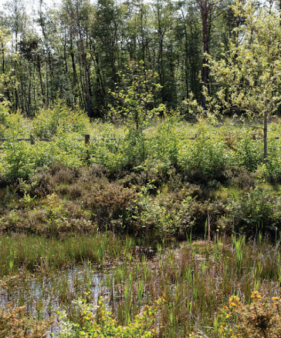
Members Training - Landscape
What makes a good development? (integrated Sustainable Urban Drainage Scheme)

Slide 23
Members Training - Landscape
Information required What makes a good development?
Landscape and Visual Impact Assessment
(the effects on landscape and views as part of EIA or as standalone document)
Design and Access Statement
(how the proposals fit the landscape context)
Landscape Proposals
(details to enable the scheme to fit with the surroundings)

Slide 24
Members Training - Landscape
Conclusion
Landscape refers to both rural and urban - it is how people relate to their surroundings and is the interaction between natural and human factors
All landscapes are important and have potential to be valued by people
Key principle is to aid the management of change recognising that changes can cause harm or be beneficial

Slide 25
Members Training - Landscape
The ministerial forward of the Conclusion
National Planning Policy Framework states:
‘Our (historic) environment – buildings, landscapes, towns and villages – can better be cherished if their spirit of place thrives, rather than withers’.
Importance of visiting the site

Slide 26
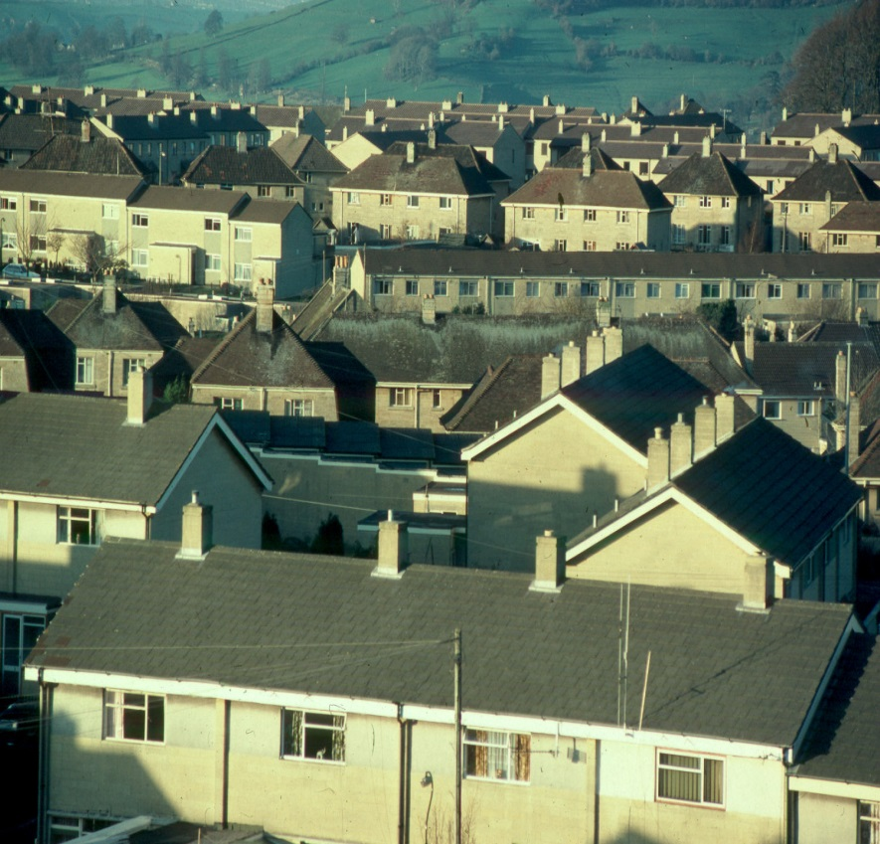
Where would we prefer to live?

Slide 27
Managing our Trees
1 Tree benefits
2 Tree protection
3 Trees and development

Slide 28
Tree Benefits
Health and Wellbeing : air quality; uv shade; learning and behaviour; patient recovery; reduction in stress and illness; recreation
Climate Change: temperature moderation; SUDS; CO2 storage
Social and Environmental: historical links; community focal points; habitats; screening; privacy; architectual enhancement
Economic: ecosystem services; employment; investment; sustainable resource; increase in property prices
Notes:
The benefit of trees is more than in the eye of the beholder.
Health and wellbeing:
Trees improve air quality – they are capable of removing and storing harmful pollutants including: Sulphur Dioxide; Nitrogen Oxides; particulates and dust; Carbon Monoxide; Cadmium; Nickel and Lead
Trees provide shade from ultra-violet radiation reducing the risk of skin cancers
Trees can aid concentration and enhance learning skills/ social functioning in children
Access to trees and green space either physically or visually can help r educe stress and illness levels and improve patient recovery.
Trees can improve our sense of place and well-being and can promote positive emotional responses by releasing scents and aromas
Mature trees and green spaces help to reduce crime levels in urban areas
Strategically planted, trees can assist in reducing noise levels.
Climate Change:
Tree planting remains one of the most cost-effective methods of controlling CO2. A single mature tree absorbs carbon at a rate of 21.6kg per year
Trees moderate localised temperature extremes. One mature tree has the same cooling effect as 10 room sized air conditioners – this can reduce local energy consumption by as much as 10% and reduce the urban heat island effect.
Trees buffer from storm water runoff and prevent erosion – 100 mature trees can capture as much as 1,137,500 litres of rainwater each year
Social and Environmental:
Trees provide historical links and community focal points
Road side trees can encourage careful driving and reduce incidences of speeding
Trees remind us of the changing seasons
Our trees provide wildlife habitats, refuges and food sources supporting our bat populations
They can provide screening and privacy or emphasize views and architecture.
Trees and woodlands provide opportunities for recreation and education
Economic :
The ecosystem service benefits such as carbon sequestration and air pollutant removal that trees provide is huge – a study in London has estimated the annual value of the area’s trees at £132.7 million.
Trees and green spaces improve residential and commercial property prices by as much as 18%
Every £1 spent on tree planting could save £7 of expenditure in other areas such as for fuel costs for heating or cooling buildings
Trees can provide employment through all aspects of the industry
Trees provide a sustainable source of compost and biofuel and the raw materials for businesses, encouraging inward investment and bringing in tourism

Slide 29
These street trees will help: - reduce glare - provide shade - moderate temperatures - improve the visual appeal and compliment and soften the hard landscaping - contribute towards the management of surface water runoff - filter and absorb airborne pollutants and particulates

Slide 30
Tree Protection
Main methods:
Tree Preservation Orders
Conservation Area Designations
Others:
Section 106 agreements
Conditions attached to planning consents
Covenants attached to deeds ( civil )
Notes:
Further information relating to TPOs and CAs on the public website
TPOs relate to amenity, not defined in law but relates primarily to visual contribution to consider
size and form; future potential as an amenity; rarity, cultural or historic value; contribution to, and relationship with, the landscape; and contribution to the character or appearance of a conservation area. Can also take into account nature conservation and climate change contribution

Slide 31
The differences between a tree protected by a TPO and a tree within a conservation area
What is protected?
What is needed to undertake works or felling?
How can the Council respond?

Slide 32
Similarities between a tree protected by a TPO and a tree within a conservation area
The same offences apply
The same exemptions apply :
- dead or dangerous parts or whole trees
- Work undertaken by or on behalf of public utilities or to remove an obstruction from a public highway
- Actively managed hedges
- Management of commercial orchards
- Minimum works to abate or remove an actionable nuisance in law
- Where the work is required to implement a full planning permission
The work is valid for two years from the decision notice for both.
Notes:
The same offences apply if works or tree felling is undertaken when no application or six weeks notice has been submitted
The same exemptions apply :
- 5 days notice should be provided to the Local Planning Authority for dead or dangerous parts or whole trees
- Work undertaken by public utilities or to remove an obstruction from a public highway are exempt, however utility companies are encouraged to notify the Local Planning Authority of works.
- Actively managed hedges are exempt too but if they are within a conservation area and have not been managed and appear as a row of trees then a notification should be sent if they are to be removed or active management commenced.
- The authority’s consent is not required for carrying out work on a tree subject to an Order and cultivated for the production of fruit in the course of a business or trade if the work is in the interests of that business or trade.
The authority’s consent is otherwise generally required for carrying out prohibited activities to a fruit tree protected by an Order and not cultivated on a commercial basis. However, the authority’s consent is not needed before pruning any tree cultivated for the production of fruit, as long as the work is carried out in accordance with good horticultural practice.
Part VIII of the Town and Country Planning Act 1990
Part II of the Planning (Listed Buildings and Conservation Areas) Act 1990
Offence to: cut down; top; lop; uproot; wilful damage; wilful destruction

Slide 33
Trees and Development
Under the UK planning system, local authorities have a statutory duty to consider the protection and planting of trees when granting planning permission for proposed development.
Relevant legislation and policies:
Section197 of the Town and Country Planning Act 1990 as amended
Policy CP7 of the adopted Core Strategy – trees in relation to green infrastructure
Retained policy NE.4 of the Bath & North East Somerset Local Plan (2007)
Policy NE6 of the emerging Placemaking Plan
Notes:
National Planning policy Framework – 117 refers to aged or veteran trees

Slide 34
Section 197 of the Town and Country Planning Act 1990 as amended:
The local planning authority has a duty —
- to ensure that adequate provision is made for the preservation or planting of trees;
- to make Tree Preservation Orders as appear necessary in connection with the granting of planning permissions

Slide 35
Policy CP7 of the Core Strategy
The integrity, multi-functionality, quality and connectivity of the strategic Green Infrastructure (GI) network will be maintained, protected and enhanced.
Opportunities will be taken to connect with, improve and extend the network.
Existing and new Green Infrastructure must be planned, delivered and managed as an integral part of creating sustainable communities.

Slide 36
Retained policy NE.4 of the Bath & North East Somerset Local Plan (2007):
Development will only be permitted where:
i. it does not have an adverse impact on trees and woodlands of wildlife, landscape, historic, amenity, productive or cultural value; and
ii. it includes the appropriate retention and new planting of trees and woodlands; and
iii it does not have an adverse impact on a veteran tree;
In the case of an unavoidably adverse impact on trees and woodlands of wildlife, landscape, amenity, productive or cultural value, compensatory provision is made.
Notes:
This will be included within the emerging Placemaking Plan:
Development proposals directly or indirectly affecting ancient woodland or ancient or veteran trees will not be accepted

Slide 37
Policy NE6 of the emerging Placemaking Plan
1) Development will only be permitted where:
a) it seeks to avoid any adverse impact on trees and woodlands of wildlife, landscape, historic, amenity, productive or cultural value; and
b) it includes the appropriate retention and new planting of trees and woodlands; and
2) If it is demonstrated that an adverse impact on trees is unavoidable to allow for appropriate development, compensatory provision will be made in accordance with guidance in the Planning Obligations SPD (or successor publication) on replacement tree planting.
3) Development proposals directly or indirectly affecting ancient woodland or ancient trees will not be permitted

Slide 38
Planning Obligations Supplementary Planning Document Section 3.5 of the document provides a mechanism to secure replacement planting off site using a fixed number replacement system.
Notes:
Developers are encouraged to replace on site. Developers will be expected to demonstrate why on-site replacement is not possible or appropriate before off-site replacement is accepted

Slide 39
Risks to trees on development sites
Felling
Unsympathetic pruning
Root severance
Trunk and canopy damage
Soil compaction
Soil contamination
Future management issues
Trees can take several years to exhibit damage following completion of a development.
Notes:
Felling
Unsympathetic pruning creating access wounds for decay causing organisms
Root severance
Trunk and canopy damage creating access for decay causing organisms
Soil compaction – waterlogging, root asphyxiation resulting in tree decline or death
Soil contamination resulting in tree decline or death – eg builders sand, cement, oil/petrol
Future management issues following completion

Slide 40
No protection = soil compaction, root asphyxiation, trunk damage
Notes:
Station Road Keynsham

Slide 41
No protection = root severance, soil compaction
Notes:
Avondale Road

Slide 42
The Solutions
1. Submission by the applicant of a tree survey, arboricultural impact assessment and arboricultural method statement demonstrating due consideration
2. Making TPOs where appropriate
3. Including appropriate conditions attached to planning consents.
4. Enforcement

Slide 43
Available Guidance

Slide 44
Good tree protection
Notes:
University of Bath

Slide 45
Successful Retention

Slide 46
Members Training – Managing our Landscape and Trees Andrew Sharland – Senior Landscape Architect andrew_sharland@bathnes.gov.uk Jane Brewer – Senior Arboricultural Officer trees_andwoodlands@bathnes.gov.uk
Questions?

