Slide 1
The Effect on Schools in Bath and North East Somerset
National Funding Formula
Stage 2
6.1
Making Bath & North East Somerset an even better place to live, work & visit

Slide 2
Making Bath & North East Somerset an even better place to live, work & visit

Slide 3
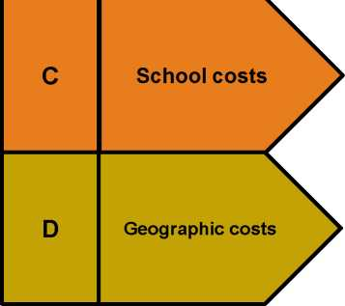
Fairer funding - school formula factors
A
Per pupil costs
Basic per-pupil funding
Deprivation | English as an Low prior attainment additional language
Lump sum and sparsity! | Rates! | Premises! | Growth!
Area cost adjustment!
B
Additional needs
Department
for Education

Slide 4
Funding allocations
Pupil Funding
Primary £2,712 per pupil
Key stage 3 £3,797 per pupil
Key Stage 4 £4,312 per pupil
Free school Meals pupils
FSM Primary and secondary £440 per FSM
FSM ever 6 Primary £540
Secondary £785
Making Bath & North East Somerset an even better place to live, work & visit

Slide 5
Funding allocations
Pupil Funding
IDACI
Band | Primary £ | Secondary £
A | 575 | 810
B | 420 | 600
C | 360 | 515
D | 360 | 515
E | 240 | 390
F | 200 | 290
Making Bath & North East Somerset an even better place to live, work & visit

Slide 6
Pupil Funding
Prior attainment
Primary £1,050
Secondary £1,550
English as an additional Language
Primary £515
Secondary £1,385
Lump Sum per schools £110,000
Premises and local issues
Transitional issues and timing.
Making Bath & North East Somerset an even better place to live, work & visit

Slide 7
Protection and transition - schools
o Schools due to gain under the formula will see per pupil increases of up to 3% in 2018-19, and up to a further 2.5% in 2019-20.
o Inclusion of a floor that will limit the overall reduction to any individual school’s budget as a result of the introduction of this national funding formula to 3% per pupil. This means that any school that would have seen a reduction greater than this will be protected; and
o The national MFG for schools of minus 1.5% per pupil year on year will continue – limiting annual reductions to manageable levels. This means that the annual level of losses felt by individual schools will be no greater than are currently allowed through local formula changes.
Making Bath & North East Somerset an even better place to live, work & visit

Slide 8
Summary
Sector | Schools with estimated Increase in budget | Schools with estimated Decrease in budget | Overall Increase | % Increase
Primary | 53 | 8 | £3,279,000 | 7.11%
Secondary | 11 | 3 | £1,836,000 | 3.86%
Total | 64 | 11 | £5,115,000 | 5.46%
Making Bath & North East Somerset an even better place to live, work & visit

Slide 9
Consultation documents on the process:
1. for the NFF
Schools national funding formula - stage 2 - Department for Education - Citizen Space
2. for the High Needs Formula
High needs funding reform - stage 2 - Department for Education - Citizen Space
The deadline for responses is 22nd March 2017
Remember – This is a consultation and the final position may change
Making Bath & North East Somerset an even better place to live, work & visit

