Slide 1
Monitoring and regulating safeguarding
Teresa Kippax, National Advisor Safeguarding
1
Notes:
1

Slide 2
Content
Purpose and Role
The approach to inspecting for quality
Care Quality Commission role in safeguarding
The CQC inspection process: what we have learnt from inspections
Improving safeguarding through regulation

Slide 3
Our purpose and role
Our purpose
We make sure health and social care services provide people with safe, effective, compassionate, high-quality care and we encourage care services to improve
Our role
We monitor, inspect and regulate services to make sure they meet fundamental standards of quality and safety and we publish what we find, including performance ratings to help people choose care
3

Slide 4
Asking the right questions about quality and safety
Safe?
Effective?
Caring?
Responsive to people’s needs?
Well-led?
4

Slide 5
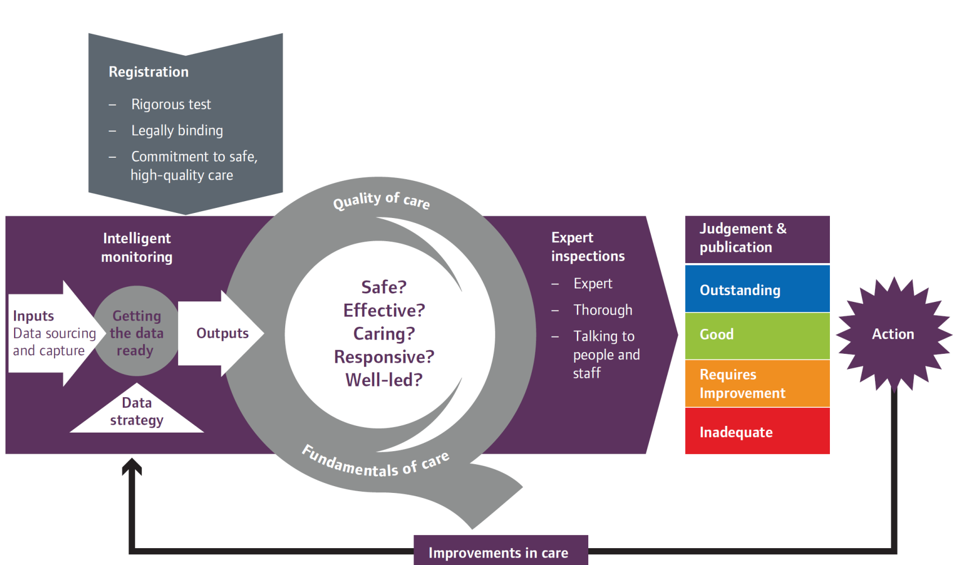
Our approach
5

Slide 6
CQC’s role in safeguarding

Slide 7
CQC’s role in safeguarding
Our approach
Working effectively
Information sharing
Intelligent monitoring
7

Slide 8
CQC’s role in safeguarding
Indicators and methodology
Intelligent Monitoring
Developing safeguarding indicators
Provider information requests
8

Slide 9
CQC’s role in safeguarding
Safeguarding Alerts
Safeguarding Concerns
ASC | Hospitals | PMS
2070 | 204 | 39
ASC | Hospitals | PMS
74905 | 4382 | 1133
9

Slide 10
CQC’s role in safeguarding
Working with others
Action on identifying abuse
Information sharing
Safeguarding strategy meetings
Local safeguarding boards
Safeguarding Adults Reviews and Safeguarding Children Reviews
10

Slide 11
CQC’s role in local safeguarding procedures
‘Think Child’
11

Slide 12
Key messages and challenges identified from our inspection approach

Slide 13
Key messages from our new approach
Safeguarding findings from our inspection approach
Training
Multi-agency working
MCA and safeguarding
Deprivation of Liberty Safeguards
13

Slide 14
Improving safeguarding through regulation
Regulation 13: Safeguarding service users from abuse and improper treatment
What is it?
Our expectation
Regulatory Action
14

Slide 15
Improving safeguarding through regulation
Prevention is better than Cure
15

Slide 16
Care Quality Commission contact details
National Customer Service Centre Citygate Gallowgate Newcastle upon Tyne NE1 4PA Phone: 03000 616161 Email: enquiries@cqc.org.uk
To tell us about a service we regulate we can be contacted in various ways, telephone, email and online, please see here for more detail of how we deal with information http://www.cqc.org.uk/content/contact-us
16

Slide 17
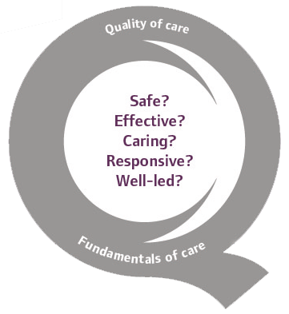
Thank you
www.cqc.org.uk
enquiries@cqc.org.uk
@CareQualityComm

Slide 18
Any Questions?

