Slide 1
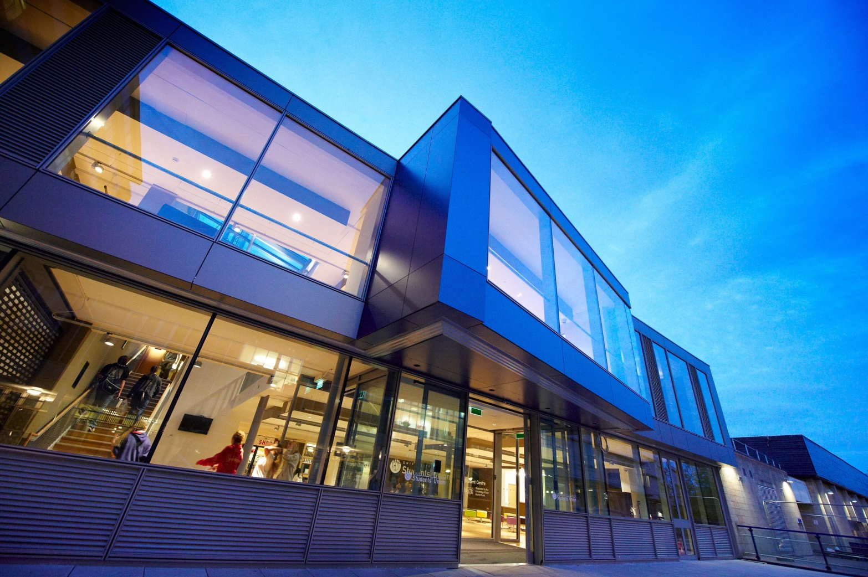
The University of Bath
Bath City Forum – Thursday 21 January 2016
Dr Nicky Kemp – Director of Policy and Planning

Slide 2
Contributions to Bath and North East Somerset
Economic
£294 million contribution to B&NES GDP in 2014/15 (6.2% of economic output);
2nd largest employer (supporting 1 in every 17 jobs in B&NES area);
Innovation Centre – new companies, new jobs, world class support (SET-squared = world’s leading business incubator);
Each additional student is estimated to add £9,560 spend in B&NES.
Social/cultural
Student volunteering and fundraising (1,650 students raised £88K for charity and volunteered in over 200 projects/events);
Outreach and curriculum enrichment in schools;
World class sports facilities (Paralympics GB training camp, NGBs);
General University Lecture Programme and community Language Classes.

Slide 3
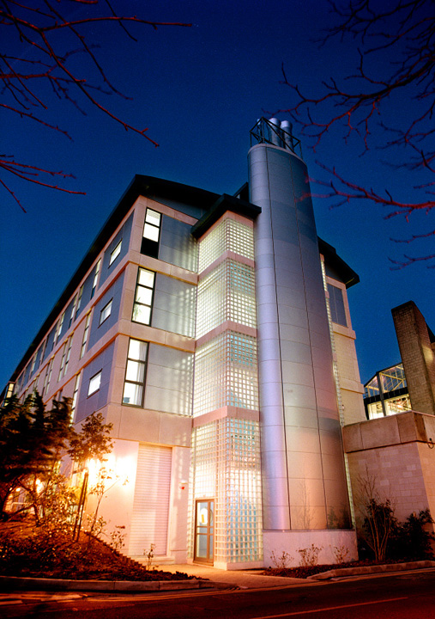
Strategic priorities – 2016 to 2019
“to become an international leader in graduate education”
We intend to:
stabilise undergraduate numbers;
strengthen research base;
invest in infrastructure;
grow graduate numbers;
enhance international profile.
whilst maintaining the quality of the undergraduate experience

Slide 4
Profile of student population
B&NES baseline = 2011/12 not 2015/16
So almost 50% of the projected growth to 2020/21 has already been delivered
1 December 2015 – Student headcount

Slide 5
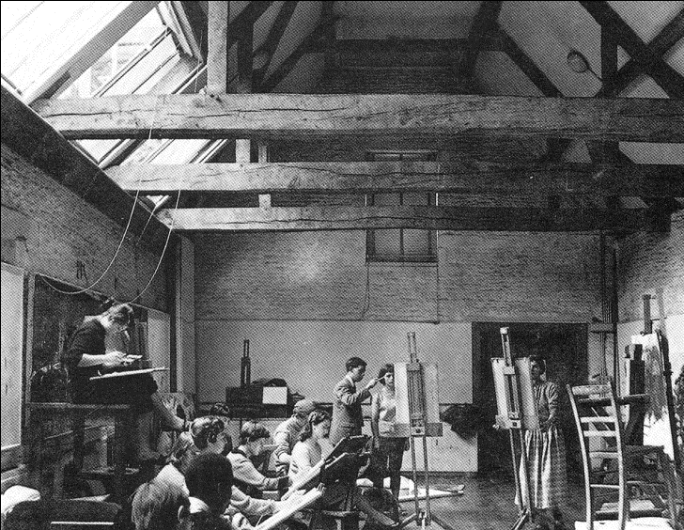
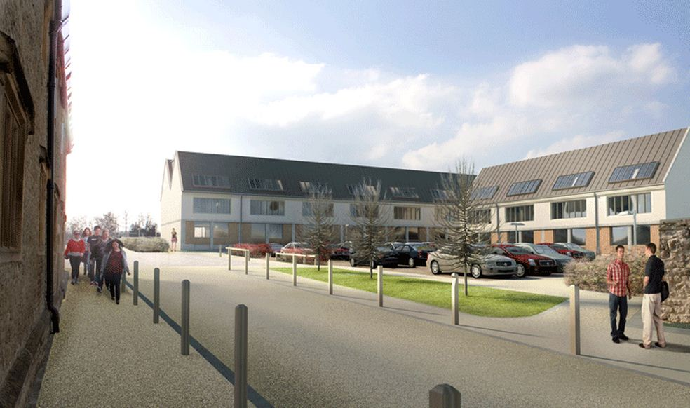
Bath City Forum – Thursday 21 January 2016
Rob Armstrong-Haworth
Director of the Vice-Chancellor’s Office

Slide 6
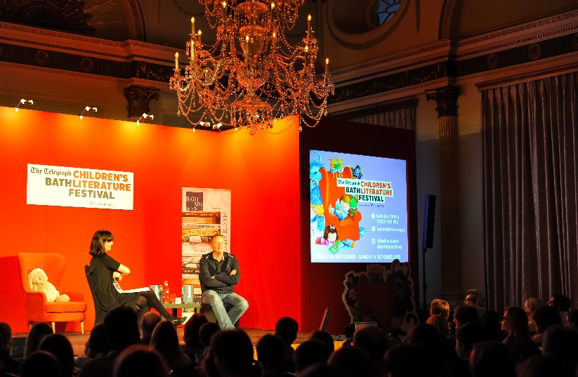
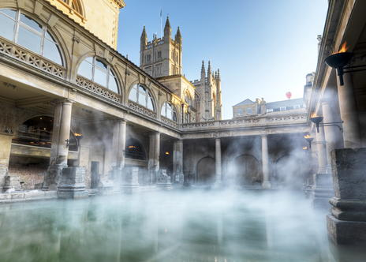
Our Vision
To be a leading University in creativity, culture and enterprise. Through inspirational teaching and research, we transform students’ lives.
Based in a world heritage city and connected to a network of international partners, Bath Spa University will ensure that its graduates are socially engaged global citizens.

Slide 7
Contributions to Bath and North East Somerset
Economic
£93.9 million economic activity supported by Bath Spa University and our students in 2014/15
5th largest employer and supports 1 in every 49 jobs in B&NES
In 2014/15, the University’s total tax contribution to the Exchequer was £21.1 million
Social and Cultural
Our history dates back to 1852 and the Bath School of Art, formed after the Great Exhibition. We are proud of our heritage in the city
Bath Spa University supports key cultural organisations including The Holburne Museum, Bath Festivals and Theatre Royal Bath, at a time of funding cuts for the arts
Bath Spa students support the community from volunteering and fundraising to the supply of teachers for our growing schools
The creative sector has been recognised by the Government as “one of the most powerful tools in driving growth” and it currently worth £77bn to the UK economy

Slide 8
Profile of student population
Our students study in Bath, Corsham, at partner colleges (e.g. Weston), via distance learning, overseas, and in schools.
36% of our student population spend little or no time at our Bath campuses.
Recently published student numbers in the Placemaking Plan consultation documents overestimated our 2020/21 student accommodation requirements.
Our submission of student numbers as part of the consultation will see a need for 1,100 additional rooms for students, 2,700 less than reported in the local press.
61% of Bath Spa University students have no student housing requirements inside Bath city centre (BA1/BA2)
43% of students studying at the University live with parents or in their own home

