Slide 1
Dr Kyle Alves
Presentation by
Partners in Procurement -
West of England
Supplying the Public Sector 2023
Sr Lecturer of Operations Mgmt & Information Systems
02 November 2023

Slide 2






Intersecting Sustainabilities:
Protecting both people and planet in supply chains

Slide 3
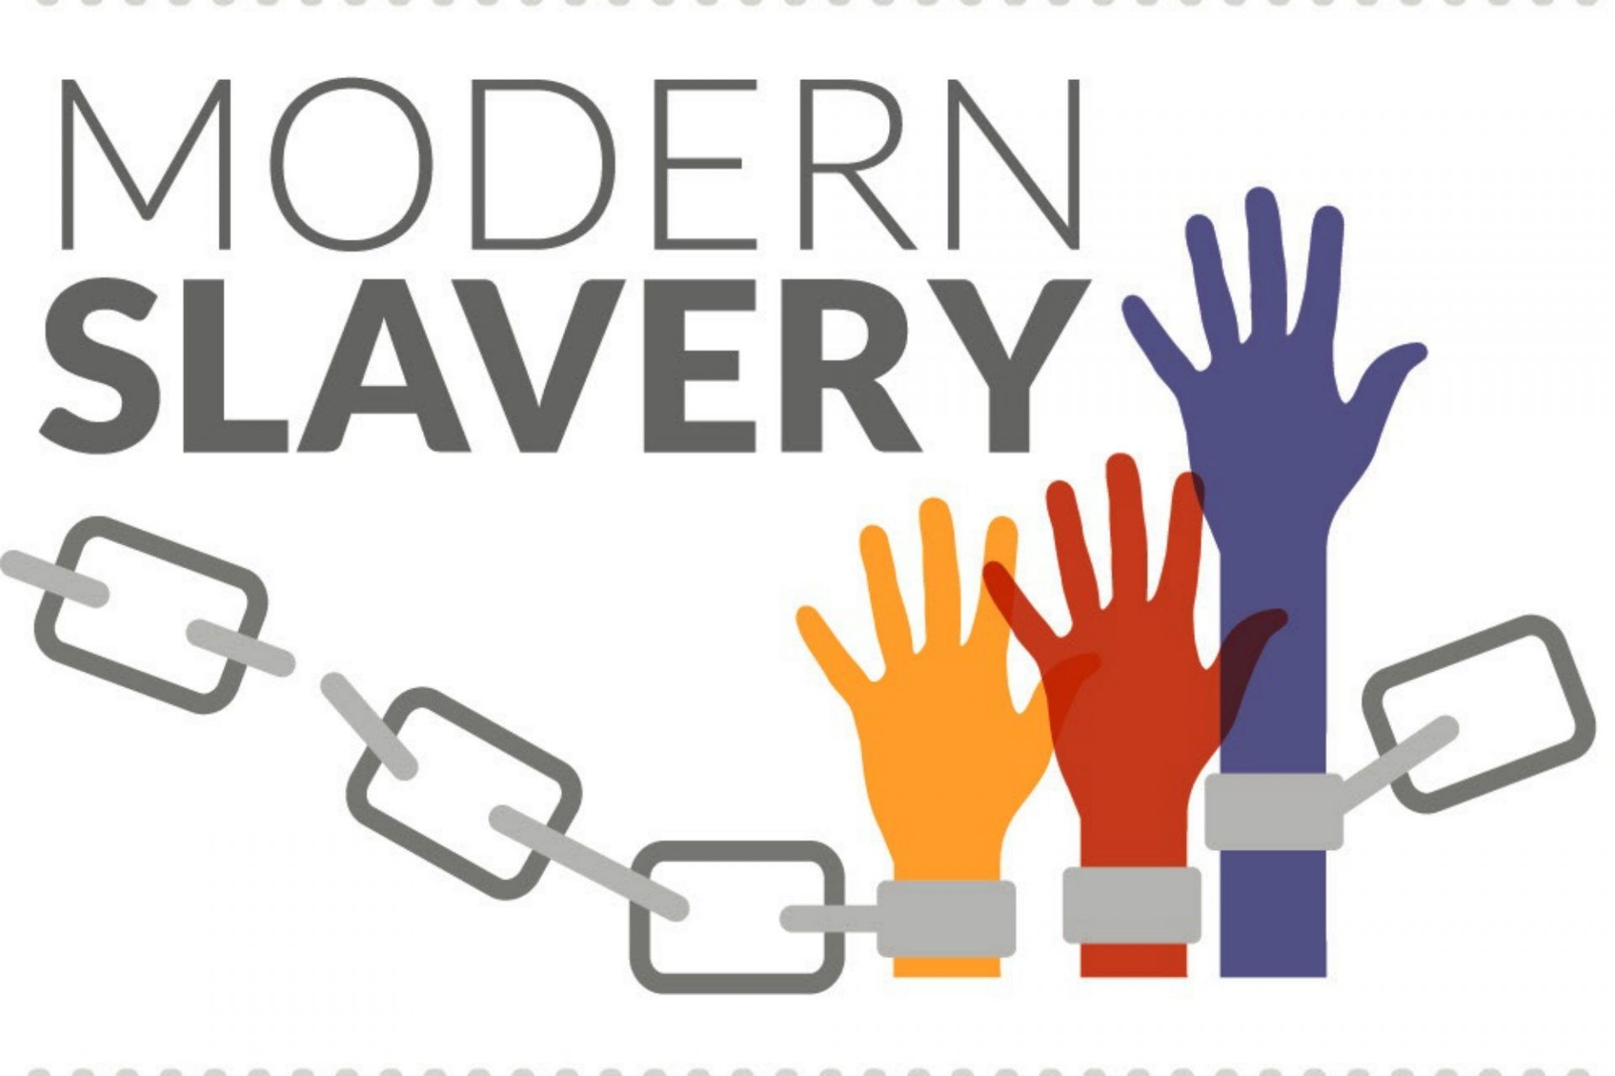
The challenge
Facing the evidence of climate change means we have to reflect on the activities that contribute, like manufacturing
In doing so, we also see the gross violations of human rights associated with modern slavery
  As climate worsens, likely to see increases in climate-driven migration; people fleeing are likely to be vulnerable to exploitation
MS PEC commissioned a study to generate evidence that can instigate change to make improvements on both fronts
Working with LUPC & Unseen

Slide 4
Our Approach
Investigate the intersection of modern slavery and climate change in multiple tiers of supply chains
Interviews:
  14 purchasing and sustainability professionals in member organisations
  21 account managers and sustainability professionals in suppliers, including tier 2 suppliers.
  5 intermediary organisations: those collecting supply chain data, mapping chains, conducting factory audits
  9 LUPC at different levels
  5 managers at modern-slavery focused organisations

Slide 5
Our (early) Findings
There’s little acknowledgement of the links between climate change and modern slavery.
There is a lack of executive support to reduce modern slavery and climate change risks.
There is little knowledge from our participants of how to provide safeguarding of vulnerable individuals.
  Current actions may provide abusers pre-warning, allowing them to move vulnerable people to different sites.

Slide 6
Policy Recommendations
A clear mandate is needed across the public sector to address modern slavery and climate change risks in supply chains
  Where successes currently exist, it is usually driven by individual or small group desire for change; unsupported by Exec teams.
Develop mechanisms to actively manage these risks
  Interviews showed only Electronics Watch could provide evidence of protecting worker rights
  Use of assurance providers who actively audit should be expanded
Build coherence between public sector bodies involved in addressing modern slavery
  This is likely going to require a national effort and support

Slide 7
Policy Recommendation 2
Separate weightings for modern slavery, climate change, and social value factors during procurement
Allow disqualification from public tendering for poor performance in these areas
Install mechanisms that increase data flow to help enforce framework conditions
  Instead of having buyers having to request production details, consider having some information flow.
Function-specific training for staff to manage issues identified during job performance
Increase spending with purchasing consortia to support the effective work that already exists

