Slide 1
New Supplier Questionnaire
Rob Logan
Director of Procurement
University of Bristol

Slide 2
New SQ
Summary
Minor sensible changes
Simplification of language
Terrible communications

Slide 3

Potted History
2015 – Public Contracts Regulations published
2016 – Selection Questionnaire published.
  Replacing the PQQ
[No change]
[No suggestion of change]
[Everyone assumed nothing would change until Procurement Bill 2024]
3 March 2023 – New SQ published
1 April 2023 – To be implemented!
1 June – Actually implemented
… and relax

Slide 4
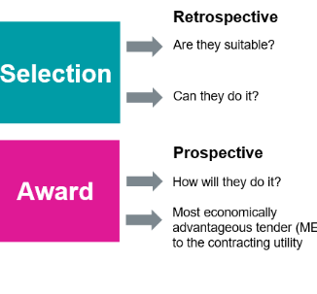
But actually a good idea
Simpler language
  ‘You’ not ‘the supplier’
Simpler structure
  One response document
  (No more ‘Annex A’ and ‘Annex D’)
Better for consortia
  You can choose either a ‘lead member’ or ‘all members’.
  A smaller organisation can rely on the financial standing of a larger partner organisation.
Gradual Replacement of the PAS91 by a Common Assessment Standard

Slide 5

Structure
Part A
Part B
Part C

Slide 6
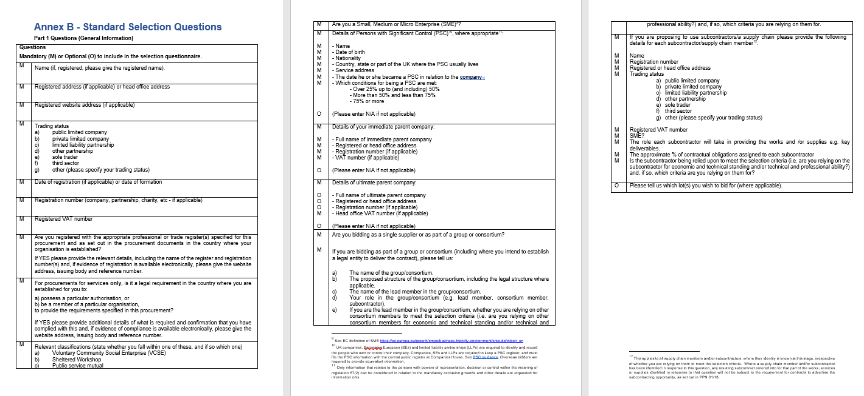
Part A – General Information

Slide 7
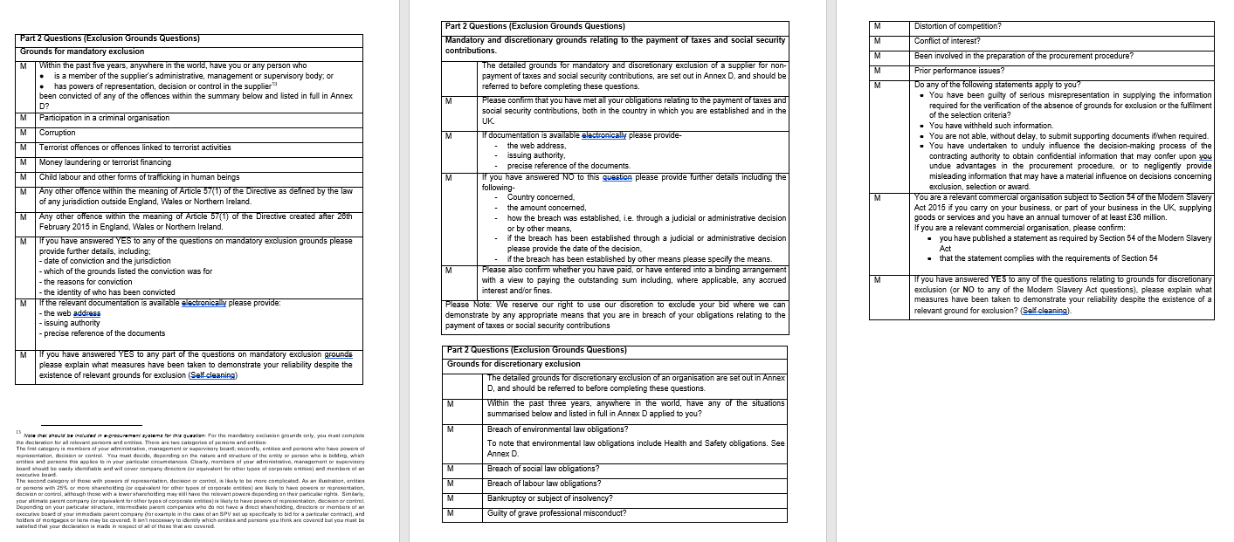
Part B – Grounds for Exclusion
Basically, you want to answer ‘no’ to these questions.
If it’s true. Otherwise explain.
Always tell the truth.

Slide 8
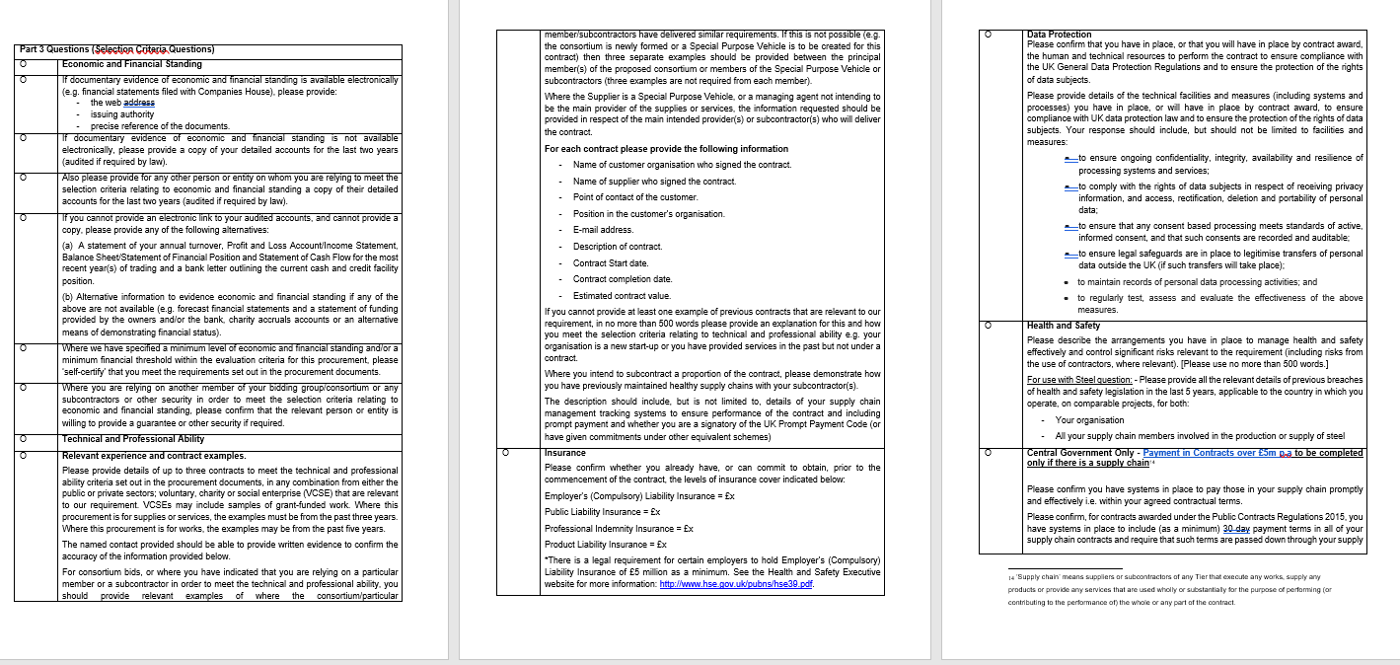
Part C – Selection Criteria
Contracting Authorities can vary Part C
Questions can be project-specific

Slide 9
Thank you

