Slide 1
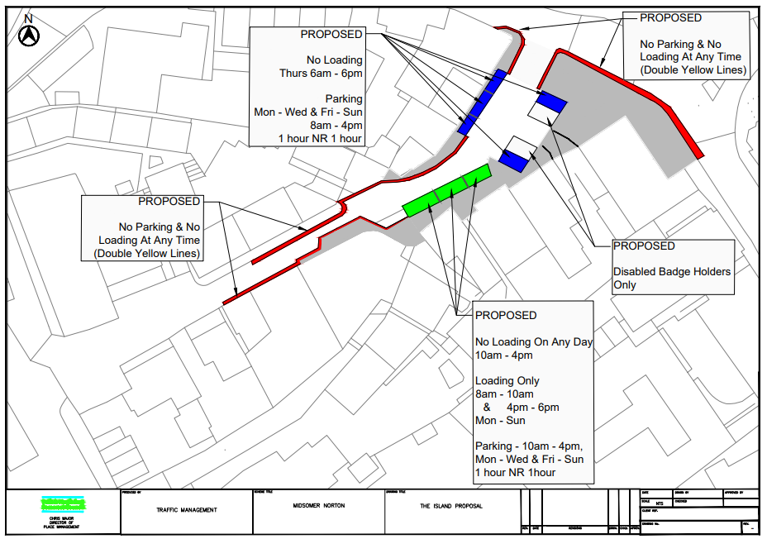
TRAFFIC PROPOSAL
Title of Proposal | (VARIOUS ROADS, IN NORTH EAST SOMERSET)(PROHIBITION AND RESTRICTION OF PARKING AND LOADING) (NO STOPPING ON ENTRANCE MARKINGS) (AUTHORISED AND DESIGNATED PARKING PLACES) (VARIATION No 2 )(ORDER 202*)
Reference |  | 24-001
Closing date for Objections and Representations |  | 11/04/2024
NOTICE is given that the Bath and North East Somerset Council proposes to make an order under provisions contained in the Road Traffic Regulation Act 1984 the effect of which will introduce the following variations to highway restrictions as shown on the plan below:
Introduce No Parking & No Loading at any time.
No Loading Thursdays 6am – 6pm.
1 hour Parking Mon – Wed & Fri – Sun 8am -4pm no return within 1 hour.
Disabled Blue Badge Holders Parking.
No Loading Mon – Sun 10am – 4pm.
Loading Only 8am – 10am & 4pm – 6pm Mon – Sun.
Full details of the proposals, together with a map and a Statement of the Council’s Reasons for proposing to make the order, may be requested, free of charge, by contacting by email council_connect@bathnes.gov.uk. The proposal may also be viewed on the Council’s website by typing in 23-004 in the search box on the home page: www.bathnes.gov.uk/permanent-traffic-order-notices
Objections and representations with respect to the proposal, together with the grounds on which they are made, must be sent by email to traffic_managementteam@bathnes.gov.uk Please quote the title of the proposal and the reference as shown above. Please note that all representations received may be considered in public by the Council and that the substance of any representation together with the name and address of the person making it could become available for public inspection.
Department: | Traffic Management Team
Chris Major – Director – Place Management
Bath & North East Somerset Council
Dated: 21st March 2024

